Slide 1
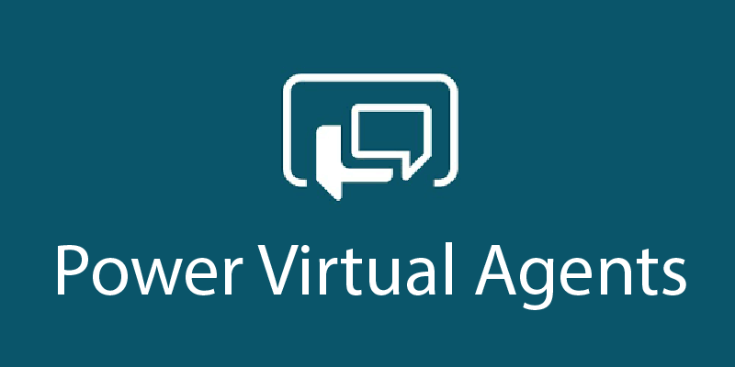

Power Platform Architecture Series
Power Virtual Agents
presented by

Slide 2
Contents
Planning your first bot
Build out your PVA bot
Extend your PVA bot with the Power Platform
Extend your bot with Azure
Advanced topics
Governance

Slide 3
Power Platform Architecture Series
Planning your first bot
presented by

Slide 4
About this series
This series is designed for Architects, Developers and IT Professionals who wish to understand how a Power Virtual Agents solution can be designed and implemented
The content is divided up into separate sessions that build into a complete* architecture
Example materials to follow along with are available here
*Some scenarios, for example integration with Dynamics Omnichannel, are simplified here for brevity

Slide 5




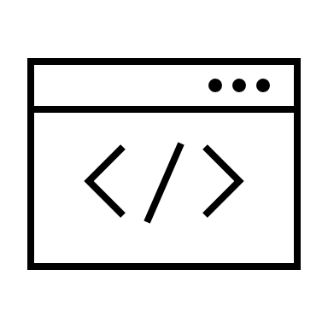
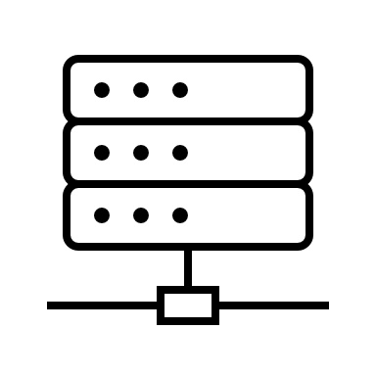

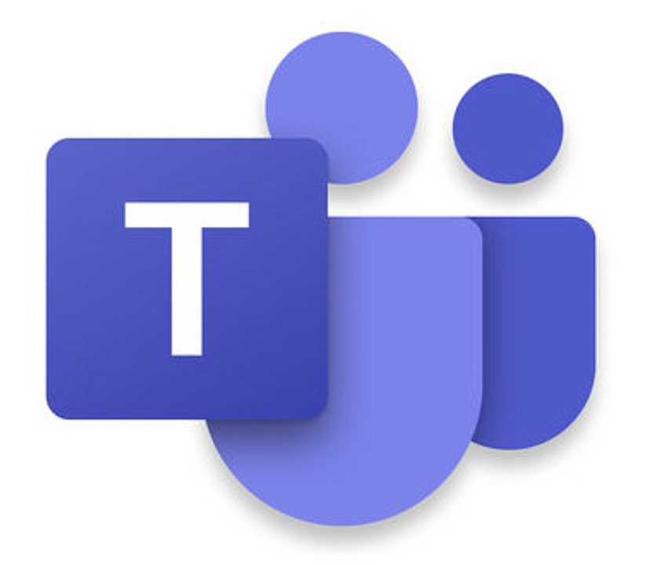



Azure Bot Service
Bot Framework Skill
Azure Active Directory
Bot Framework Skill
Omnichannel for Customer Service
Environment
Channels
BF Composer Dialog
BF Composer Dialog
Escalate
User Topic
SaaS
Web
Entity
Custom
User Topic
Flow
Entity
Custom
User Topic
Entity
Entity
Flow
QnA Maker
Teams
User Topic
Connectors
Entity
Entity
Flow
Entity
Entity
System Topic
Flow
System Topic
Flow
AI Builder
App
Analytics
Solution
Desktop
RBAC
Microsoft Dataverse
ALM

Slide 6
About this session
This first session provides background & helps you understand some of the topics to think about before you get started.

Slide 7
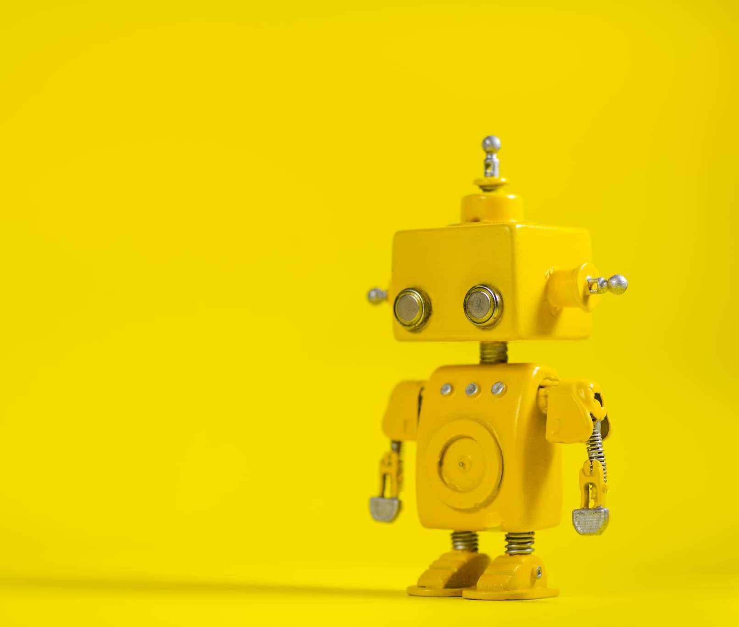
Why Power Virtual Agents?

Slide 8
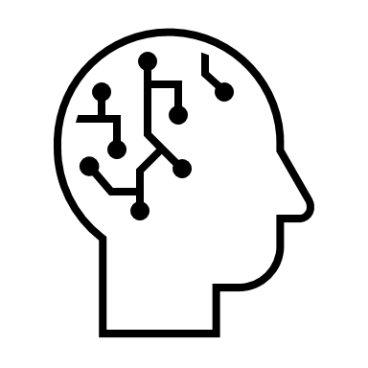
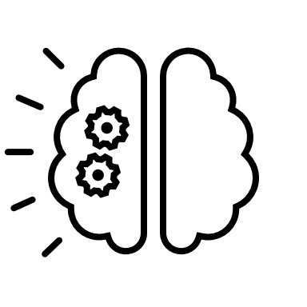


Why bots?
AI/Natural Language Understanding
Nothing new to learn
A new channel that customers already use – and can self-service
Higher speed/lower cost of implementation

Slide 9
Chatbots can help, but…
Bots are hard to create and expensive to maintain
There is impedance between the subject matter experts with answers – and the developers and scientists who create bots
Bots aren’t useful unless they can integrate with the backend and provide personalized answers

Slide 10
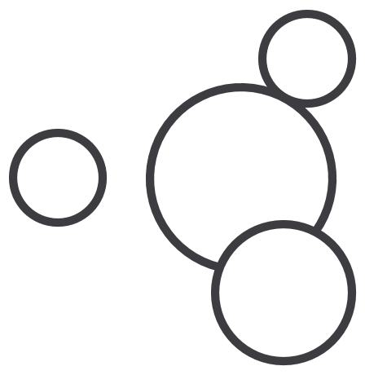
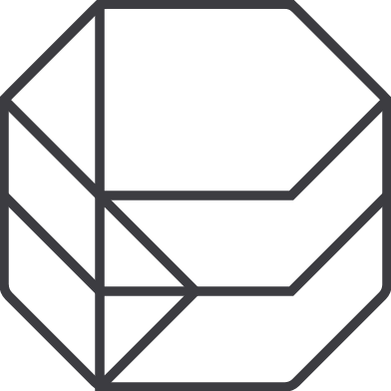
Microsoft Power Platform
The low-code platform that spans Office 365, Azure, Dynamics 365, and standalone applications
Innovation anywhere. Unlocks value everywhere.
Power BI
Business analytics
Power Apps
Application development
Power Automate
Process automation
Power Virtual Agents
Intelligent virtual agents
Data connectors
Portals
AI Builder
Common Data Service

Slide 11
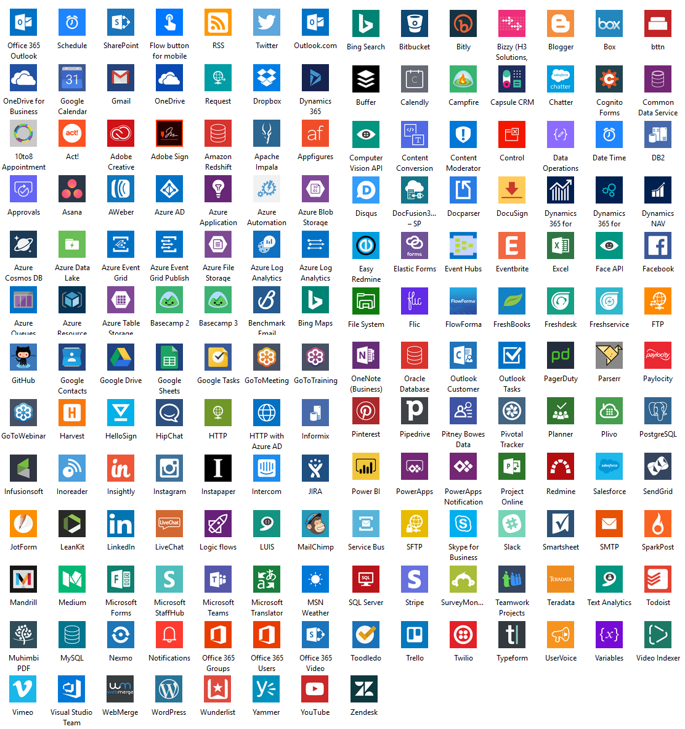
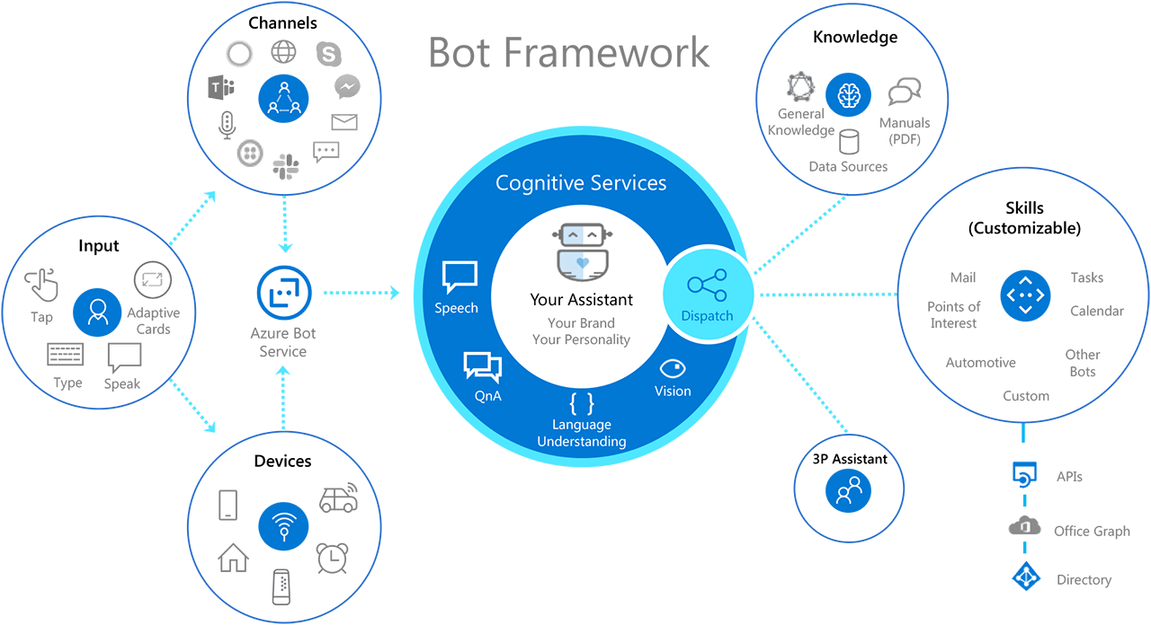
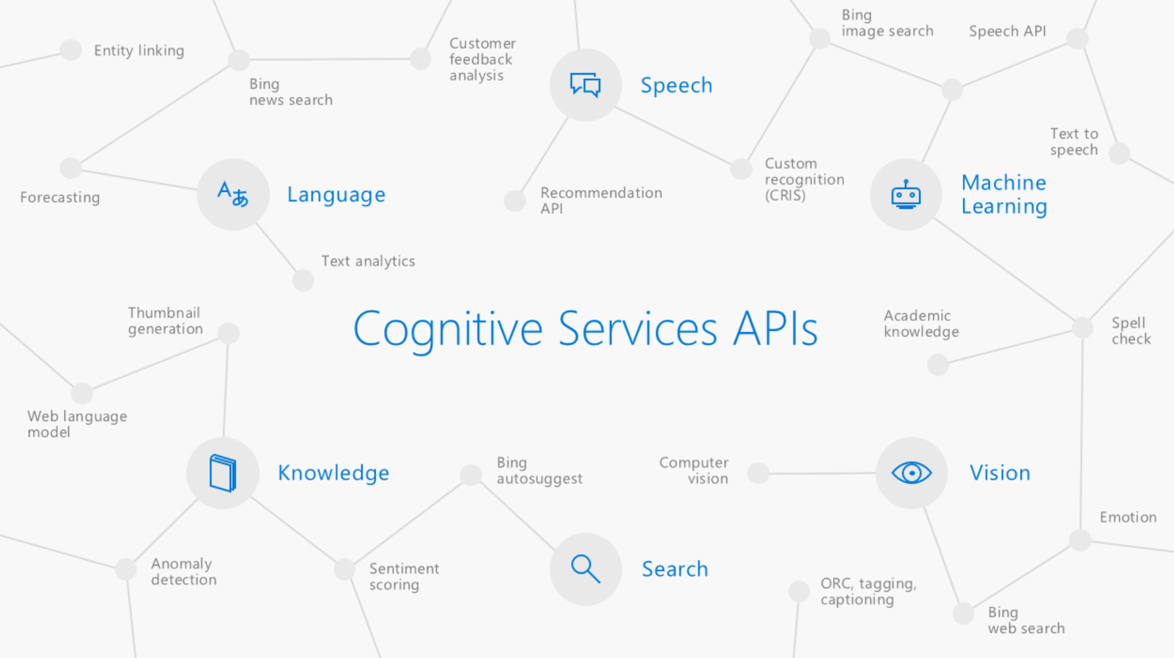
Built on Power Platform & Bot Framework
Access to Flow, custom models through AI Builders and 100s of pre-built connectors
Easy, no-cliff access to the full power of the Azure Bot Framework
Integrated with Azure Cognitive Services
Power Virtual Agents
Azure Cognitive Services
Bot Framework
Power Platform

Slide 12
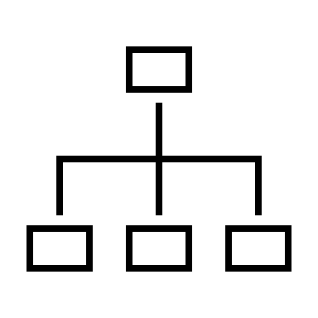

Why Power Virtual Agents?
Rapid bot creation without code
Bring developers and SME’s together to create
Extend with Power Automate and Azure Bot Framework
Choose from multiple channels and integrate with human agents
Use built in analytics to iterate and enhance

Slide 13
Planning your first PVA Bot
Audience
Interactivity
Development approach
Non-functional requirements

Slide 14
Audience
Departmental Bot
Created by SME/Citizen developer
IT provide tools and infrastructure but is passive
Internal Bot
Collaboration between SMEs and IT
Connecting to SaaS, backend ERP, and Office suite
External Bot
Driven by IT/Dev with SME input
ALM, visual design , and scale planning all important
Fast to deliver
Lower governance
Dataverse for Teams
IT provides ALM, deployment and develop interactivity
SME develop/manage content
Single sign-on/auth
Escalate to a live agent
Teams, Intranet
Connecting to backend APIs
Web, App, Messaging
Bot Framework skills

Slide 15
Interactivity
Calling existing backend APIs, SaaS
Complex conversations
Triage/deflection for a live agent

Slide 16
Non-functional requirements
Design/styling
Security/Single sign-on
Custom Analytics
Data Retention
Application Lifecycle

Slide 17
Fusion teams with PVA
PAST…
I’d like to…
I’d like to…
NOW
Here are some blocks! Go for it
Here you go…
Look what we did!

Slide 18
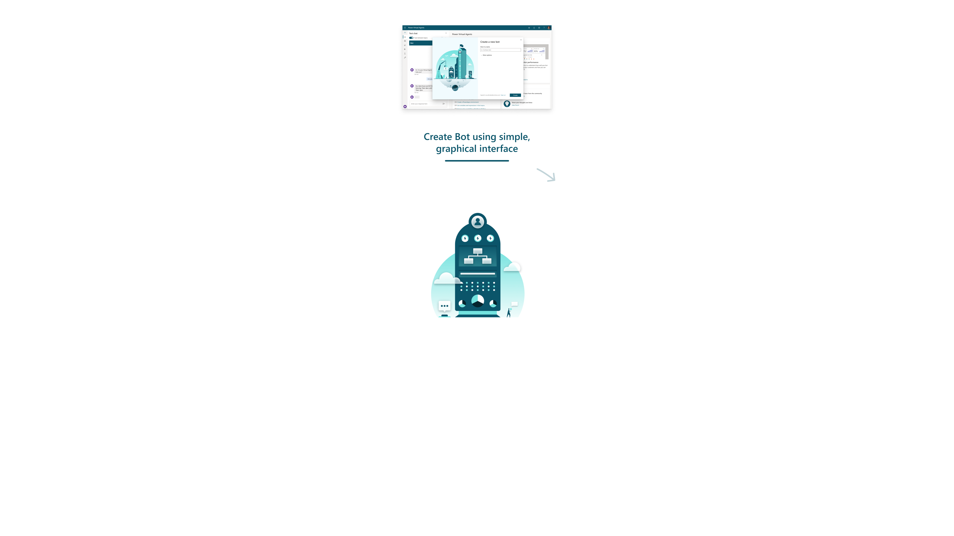
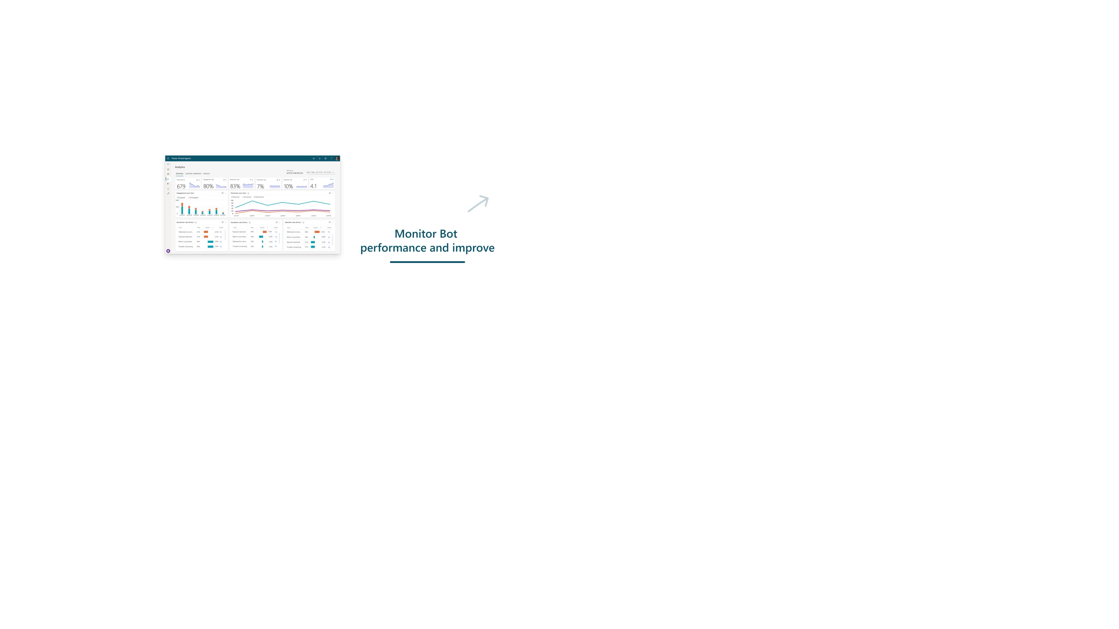
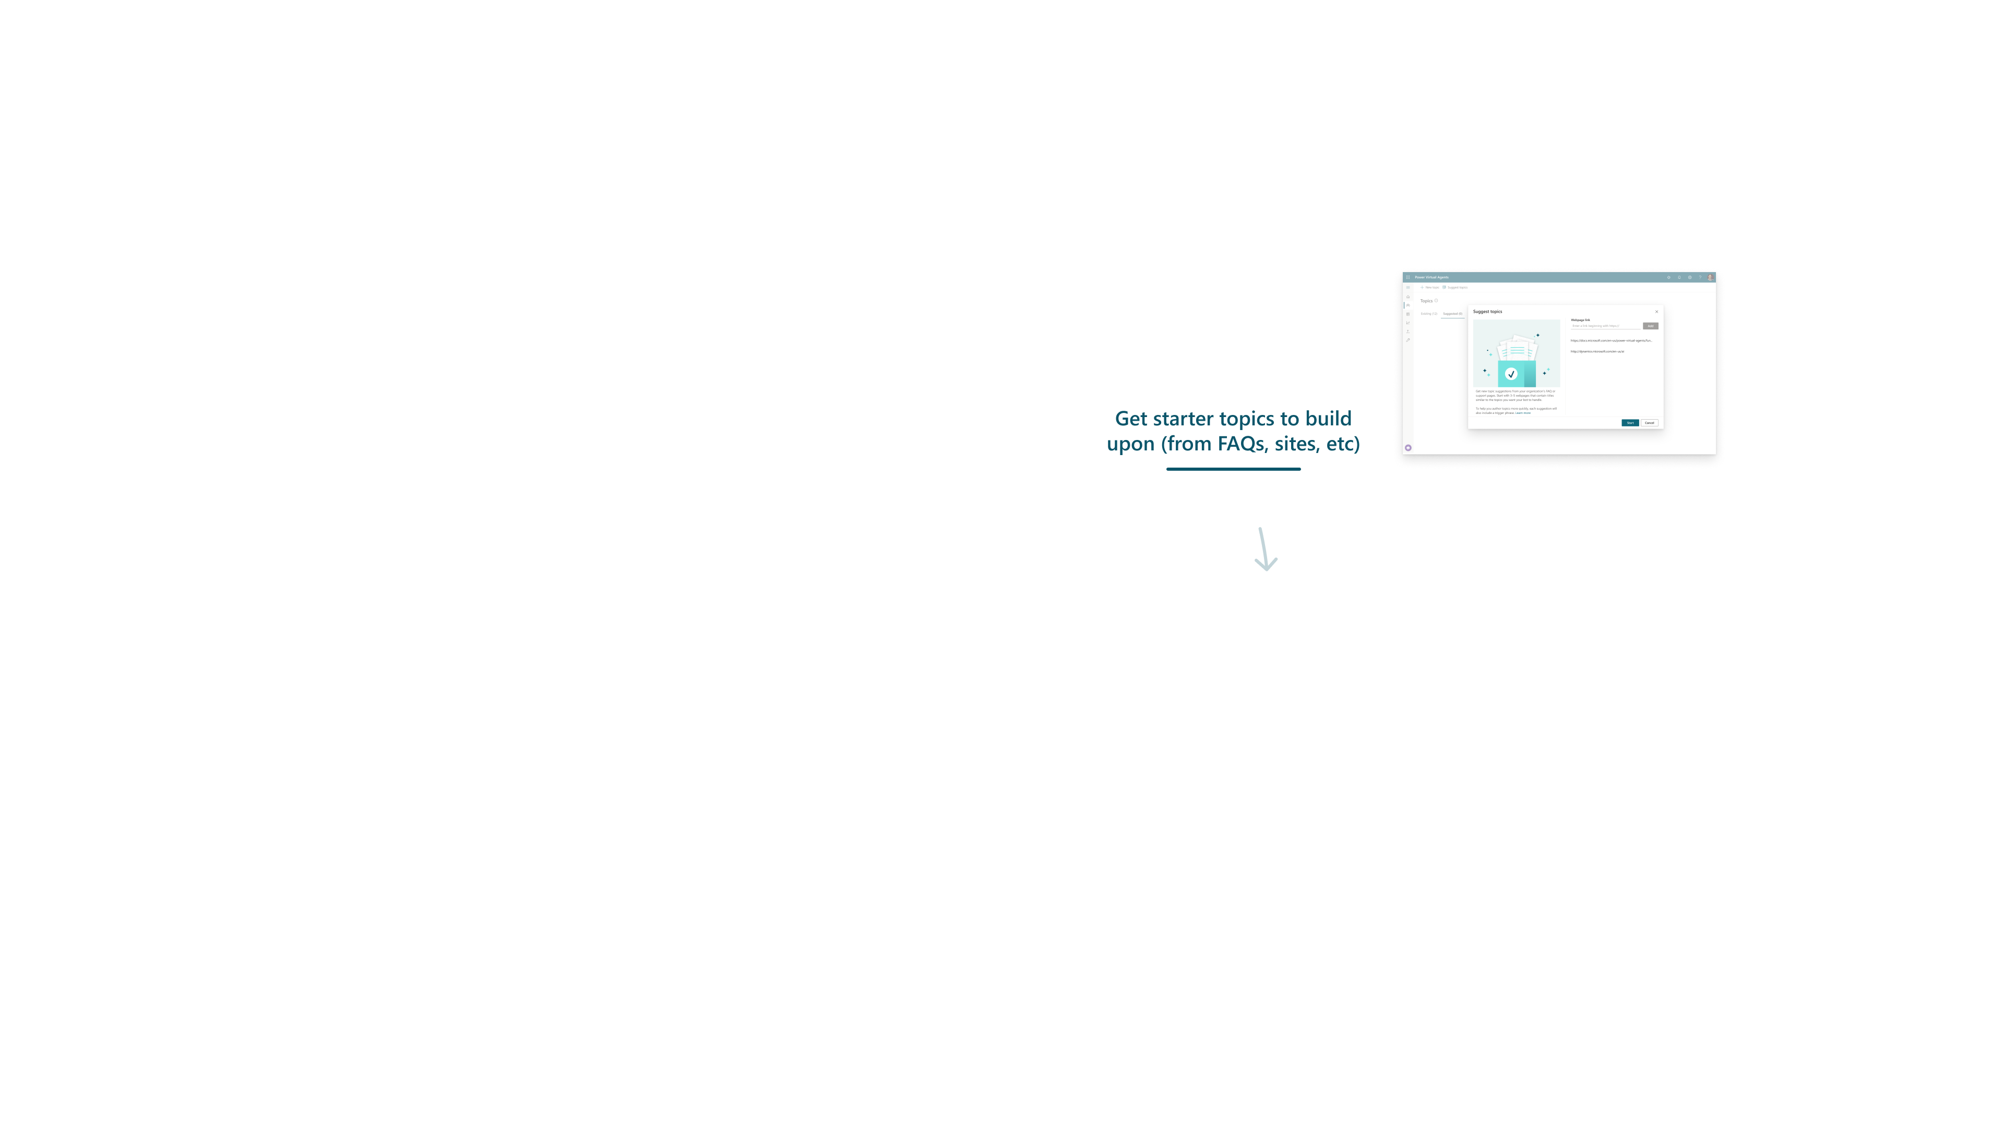
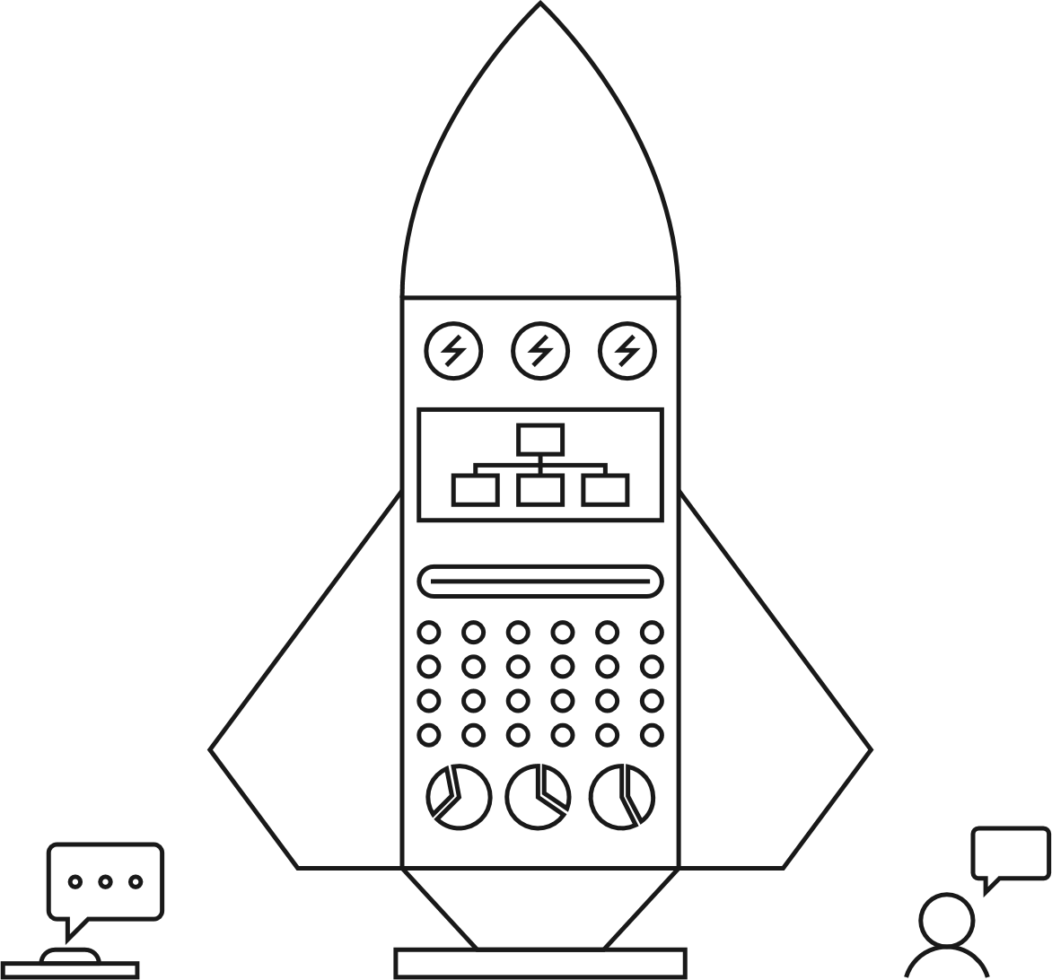
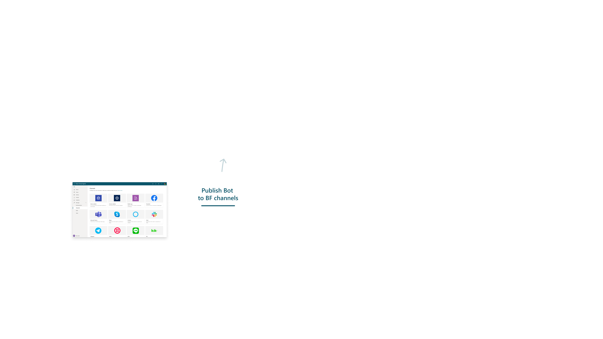
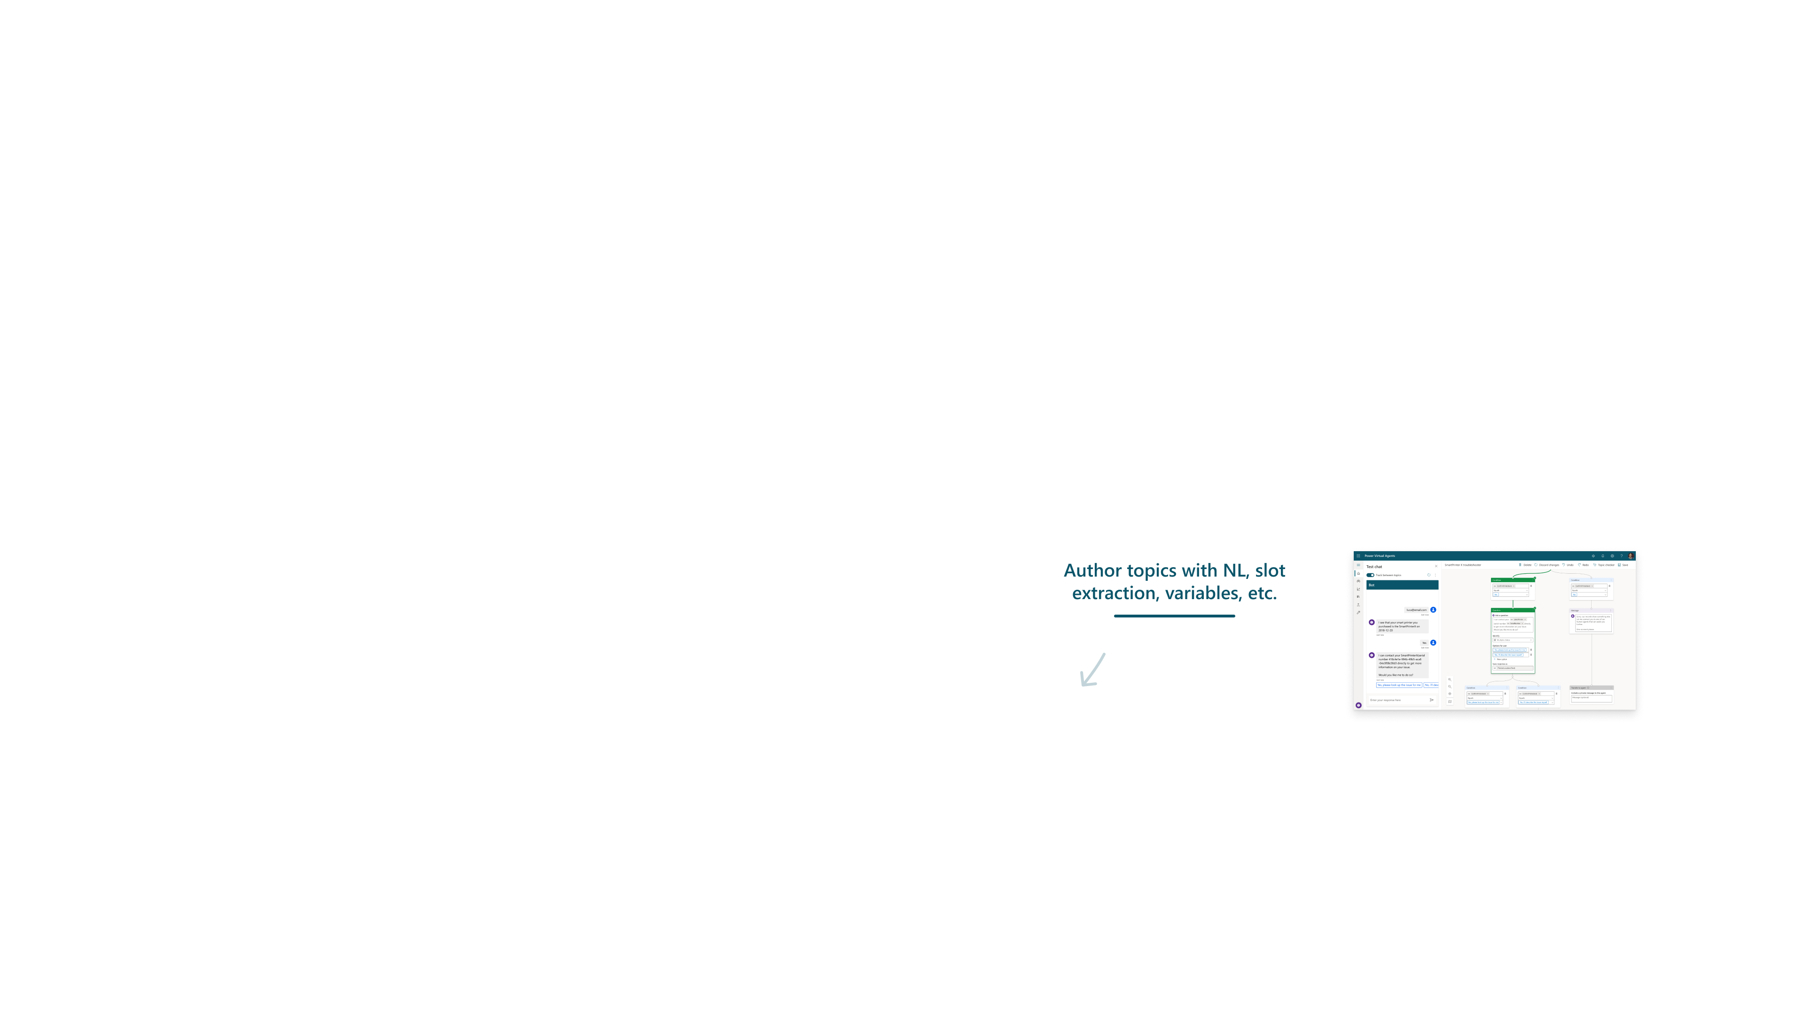
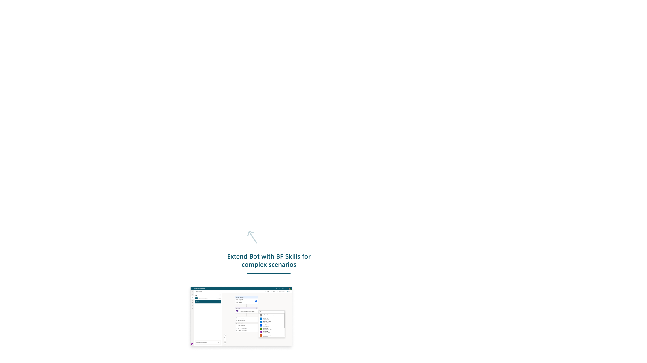
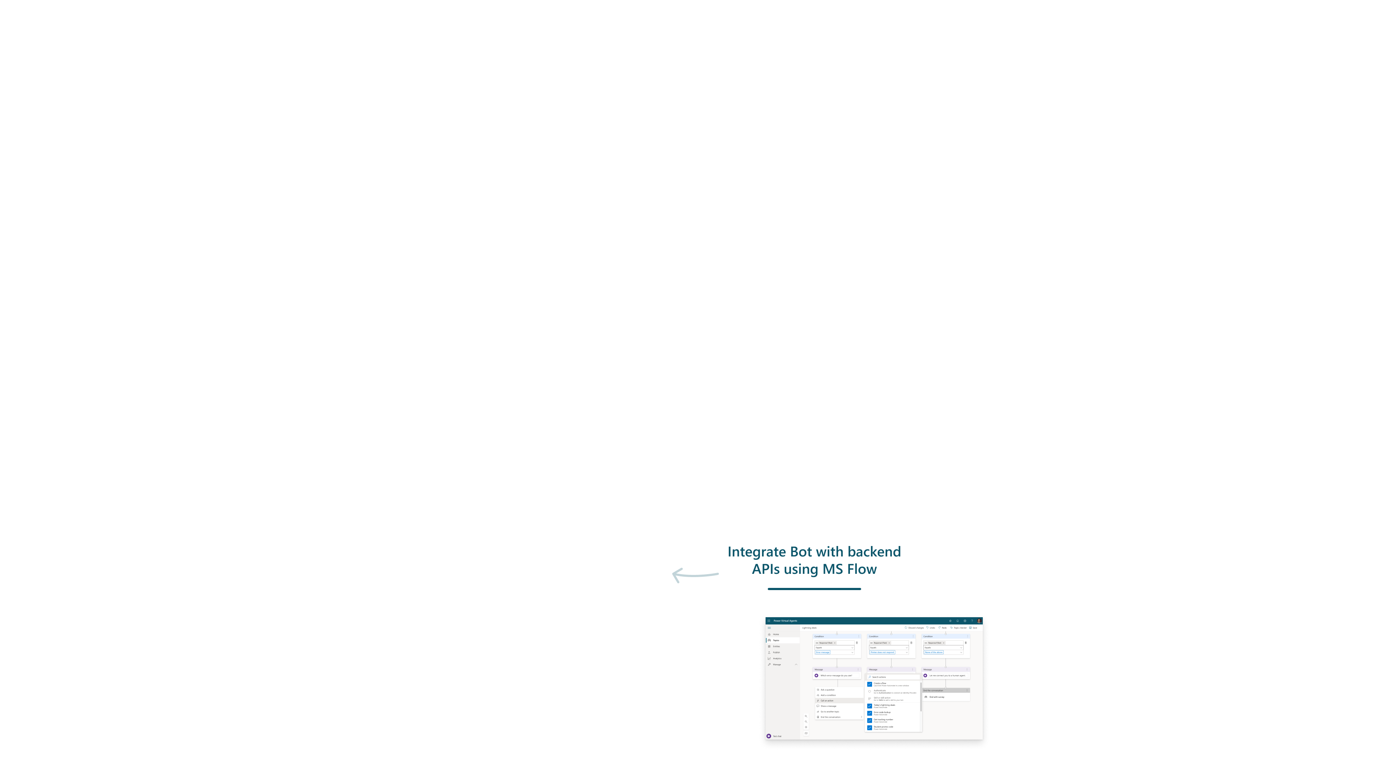
Iteration
Create Bot using simple, graphical interface
Monitor Bot performance and improve
Get starter topics to build upon (from FAQs, sites, etc)
Publish bot to channels
Author topics with NL, slot extraction, variables, etc
Extend Bot with BF Skills for complex scenarios
Integrate Bot with backend APIs using Power Automate

Slide 19
Hackathons
Day 1 | Participants work though “PVA in a day” training content. Course materials available from https://aka.ms/PVAinaDayPackage
Day 2 | Morning: attendees split into teams (mixed IT and SME) then brainstorm bot ideas. Teams come back and present ideas to the group Afternoon: teams work together to build out their PVA bot
Day 3 | Morning: teams continue building their bot, and prepare to present it to the group Afternoon: teams present to their bot to the wider group (awards/prizes optional)
For organizations interested in developing Internal or Departmental bots, Hackathons are a great way to show how quickly a PVA bot can be built
Attendees should be fusion teams – a mix of IT/Dev and subject matter experts.
Common schedule for a 3-day hackathon:

Slide 20
Licensing PVA
PVA bots are generally licensed based on “sessions”
A session is an interaction between a user and bot. The session begins when a user topic is triggered and ends when one of these conditions is met—either: The user's questions are answered; or the conversation exceeds 60 minutes or 100 turns
Power Automate usage through PVA (i.e., using the PVA trigger) is included in the license cost (including Premium connectors)
10GB of Dataverse DB capacity, and 20 GB Dataverse file capacity are also included.
Get pricing for your region

Slide 21
Summary
This session detailed some of the considerations an architect should make to understand how they can best use Power Virtual Agents successfully.
Of key importance is understanding the audience for your bot, the types of interactivity it needs to have, and any important non-functional requirements.
Consider how hackathons and an iterative approach can shape how bots are developed.
Understand how PVA is licensed.

Slide 22
Power Platform Architecture Series
Build out your PVA bot
presented by

Slide 23
About this series
This series is designed for Architects, Developers and IT Professionals who wish to understand how a Power Virtual Agents solution can be designed and implemented
The content is divided up into separate sessions that build into a complete* architecture
Example materials to follow along with are available here
*Some scenarios, for example integration with Dynamics Omnichannel, are simplified here for brevity

Slide 24
About this session
This session covers some of the key capabilities of PVA that can be used for authoring topics, triggering the right content for the bot end user, measuring the performance of the bots and various channels available.

Slide 25
Azure Bot Service
Bot Framework Skill
Azure Active Directory
Bot Framework Skill
Omnichannel for Customer Service
Environment
Channels
BF Composer Dialog
BF Composer Dialog
Escalate
User Topic
SaaS
Web
Entity
Custom
User Topic
Flow
Entity
Custom
User Topic
Entity
Entity
Flow
QnA Maker
Teams
User Topic
Connectors
Entity
Entity
Flow
Entity
Entity
System Topic
Flow
System Topic
Flow
AI Builder
App
Analytics
Solution
Desktop
RBAC
Microsoft Dataverse
ALM

Slide 26
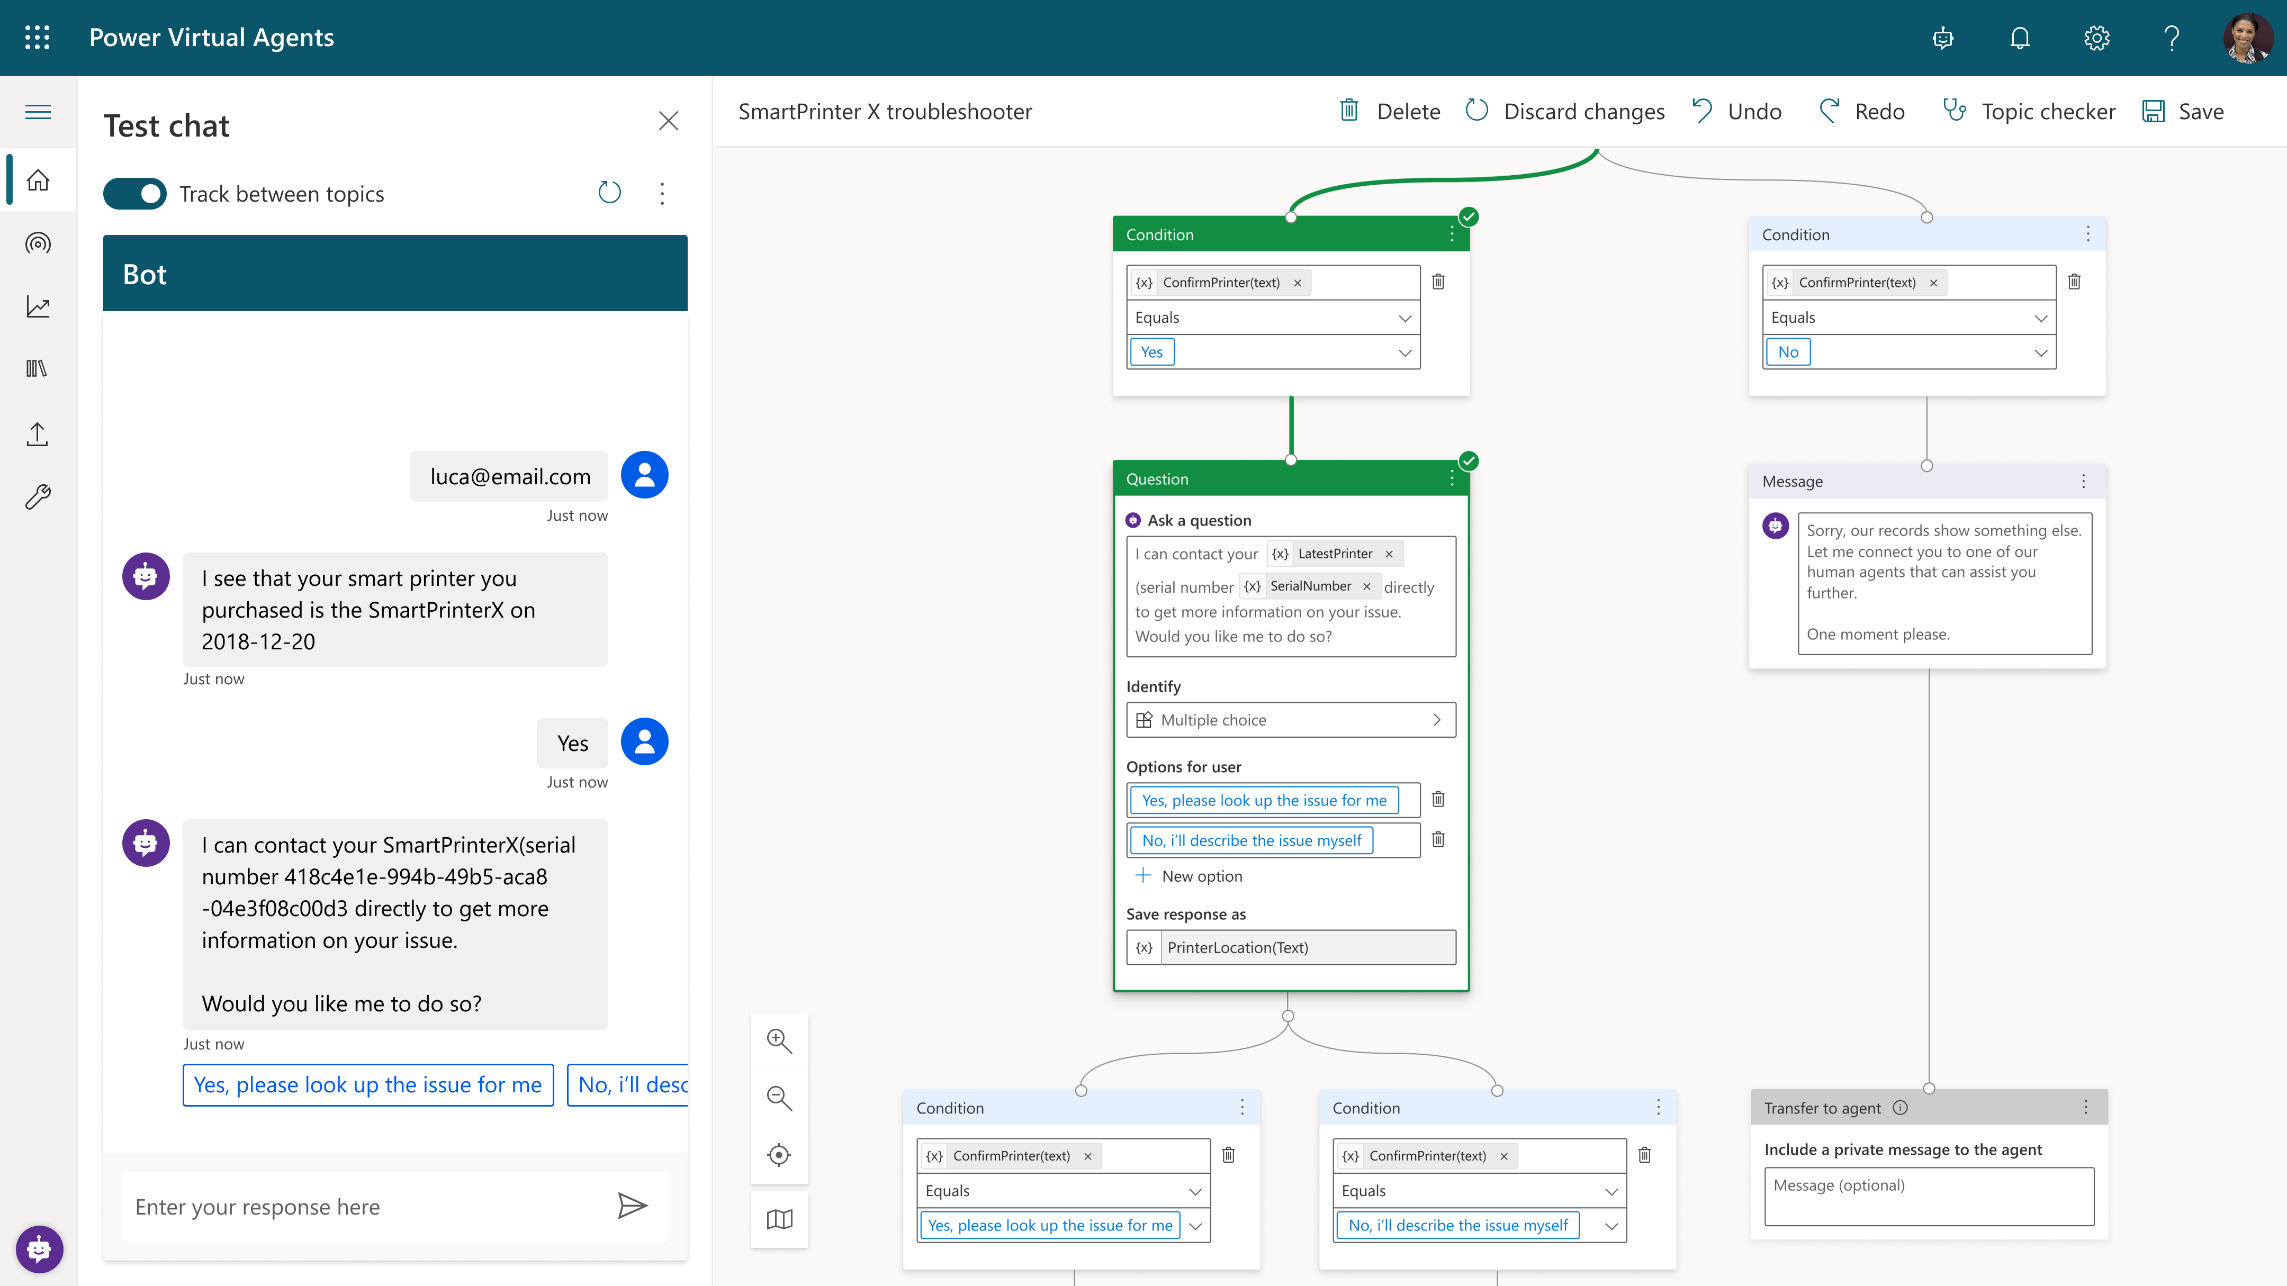
Topic authoring
Simple, graphical bot creation
Easily create Topics and Bots through a simple, intuitive graphical interface.
Extract info from user responses
Recognize, extract, and act on dozens of common entities in a user’s responses (currencies, ages, dates, times). Create your own custom entities, like model numbers.
Remember user responses
Store user information for later use in variables and apply them to branch out or create complex conversations.

Slide 27
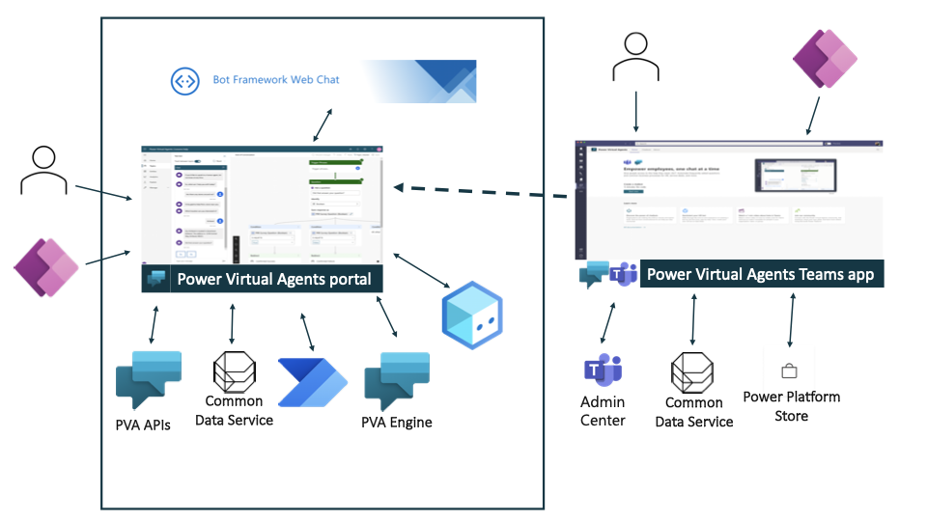
Topic authoring

Slide 28
Topic authoring
Purpose of authoring a topic is to resolve a user’s query, this essentially involves two parts
1
2
Detect
Correct
Intent
Deliver
Best
Response
Incoming User query
Triggering
and Best Practices
Conversation design and
Best Practices

Slide 29
Topic authoring
Step 1. Design topics
2. Add trigger phrases & Entities
3. Build conversation path
Scope the use case and construct the conversation path to guide customers to the right solution, fast
Topic creation
Co-authoring of topics
Entity Management
Action Management
Understand what users ask and decide the topics to automate for Virtual Agent to handle
Get topic suggestions using Suggested topics
Understand how users express the topics to connect them with right content

Slide 30
Topic authoring
Topics
System topics
User topics
Suggested topics
Dialog
Message node
Question node
Action node
End of conversation
Agent transfer node
Authentication node
Composer topics (coming soon)
Condition node
Trigger phrases
Fall back topic
Go To Topic

Slide 31
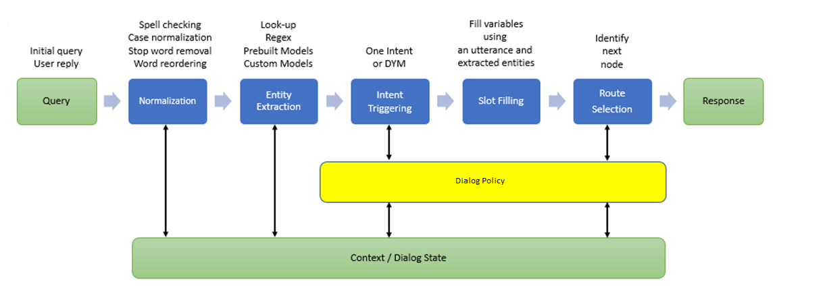
Triggering
1
2

Slide 32
Triggering
Match the correct Topic
Avoid repetitive questions
Faster conversation

Slide 33
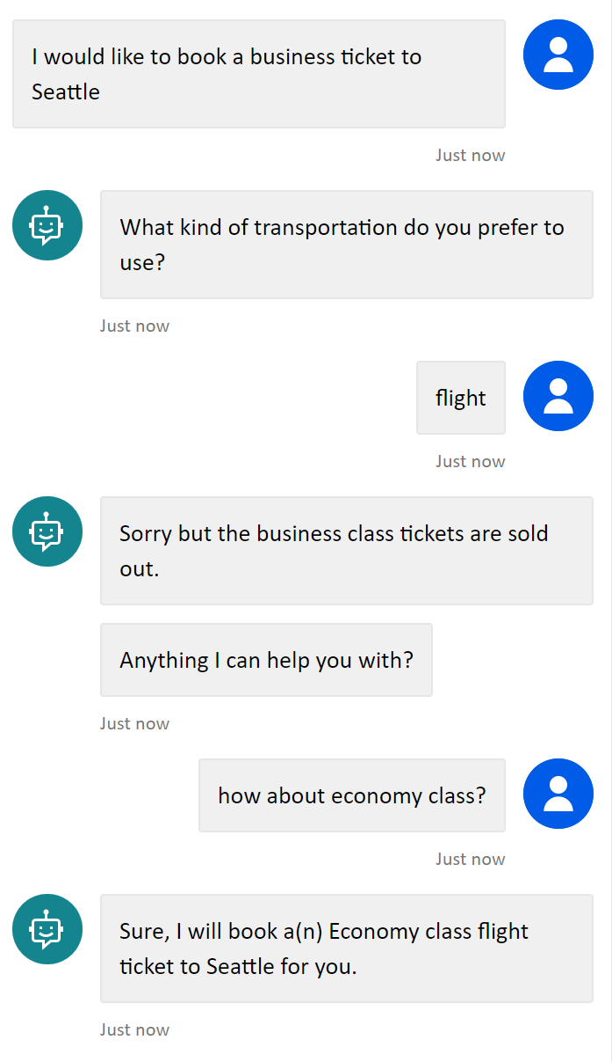
Triggering
Finds semantically the closest trigger phrase with the given user query.
Trigger
Phrase
Topic A
Trigger
Phrase
User Query
Trigger
Phrase
Topic B
Trigger
Phrase
…
Trigger
Phrase

Slide 34
Entity
aka NER (Named Entity Recognition)
Understand given user query and provide more information to the slot filler
27 predefined system entities including City, State, Date Time, Age, etc.
Custom entities defined by Author

Slide 35

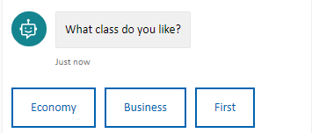
Slot Filling
User might say…
Airplane
I want to take an airplane
flight
Airplane to Seattle
Sorry, economy class flight ticket please
Understand user input to the specific question and select the value for the variables.
Variable types
Current variable
Future variable (Greedy slot filling)

Slide 36
Slot Filling
User might say…
Airplane
I want to take an airplane
flight
Airplane to Seattle
Sorry, economy class flight ticket please
Understand user input to the specific question and select the value for the variables.
Variable types
Current variable
Future variable (Greedy slot filling)
Skipped

Slide 37
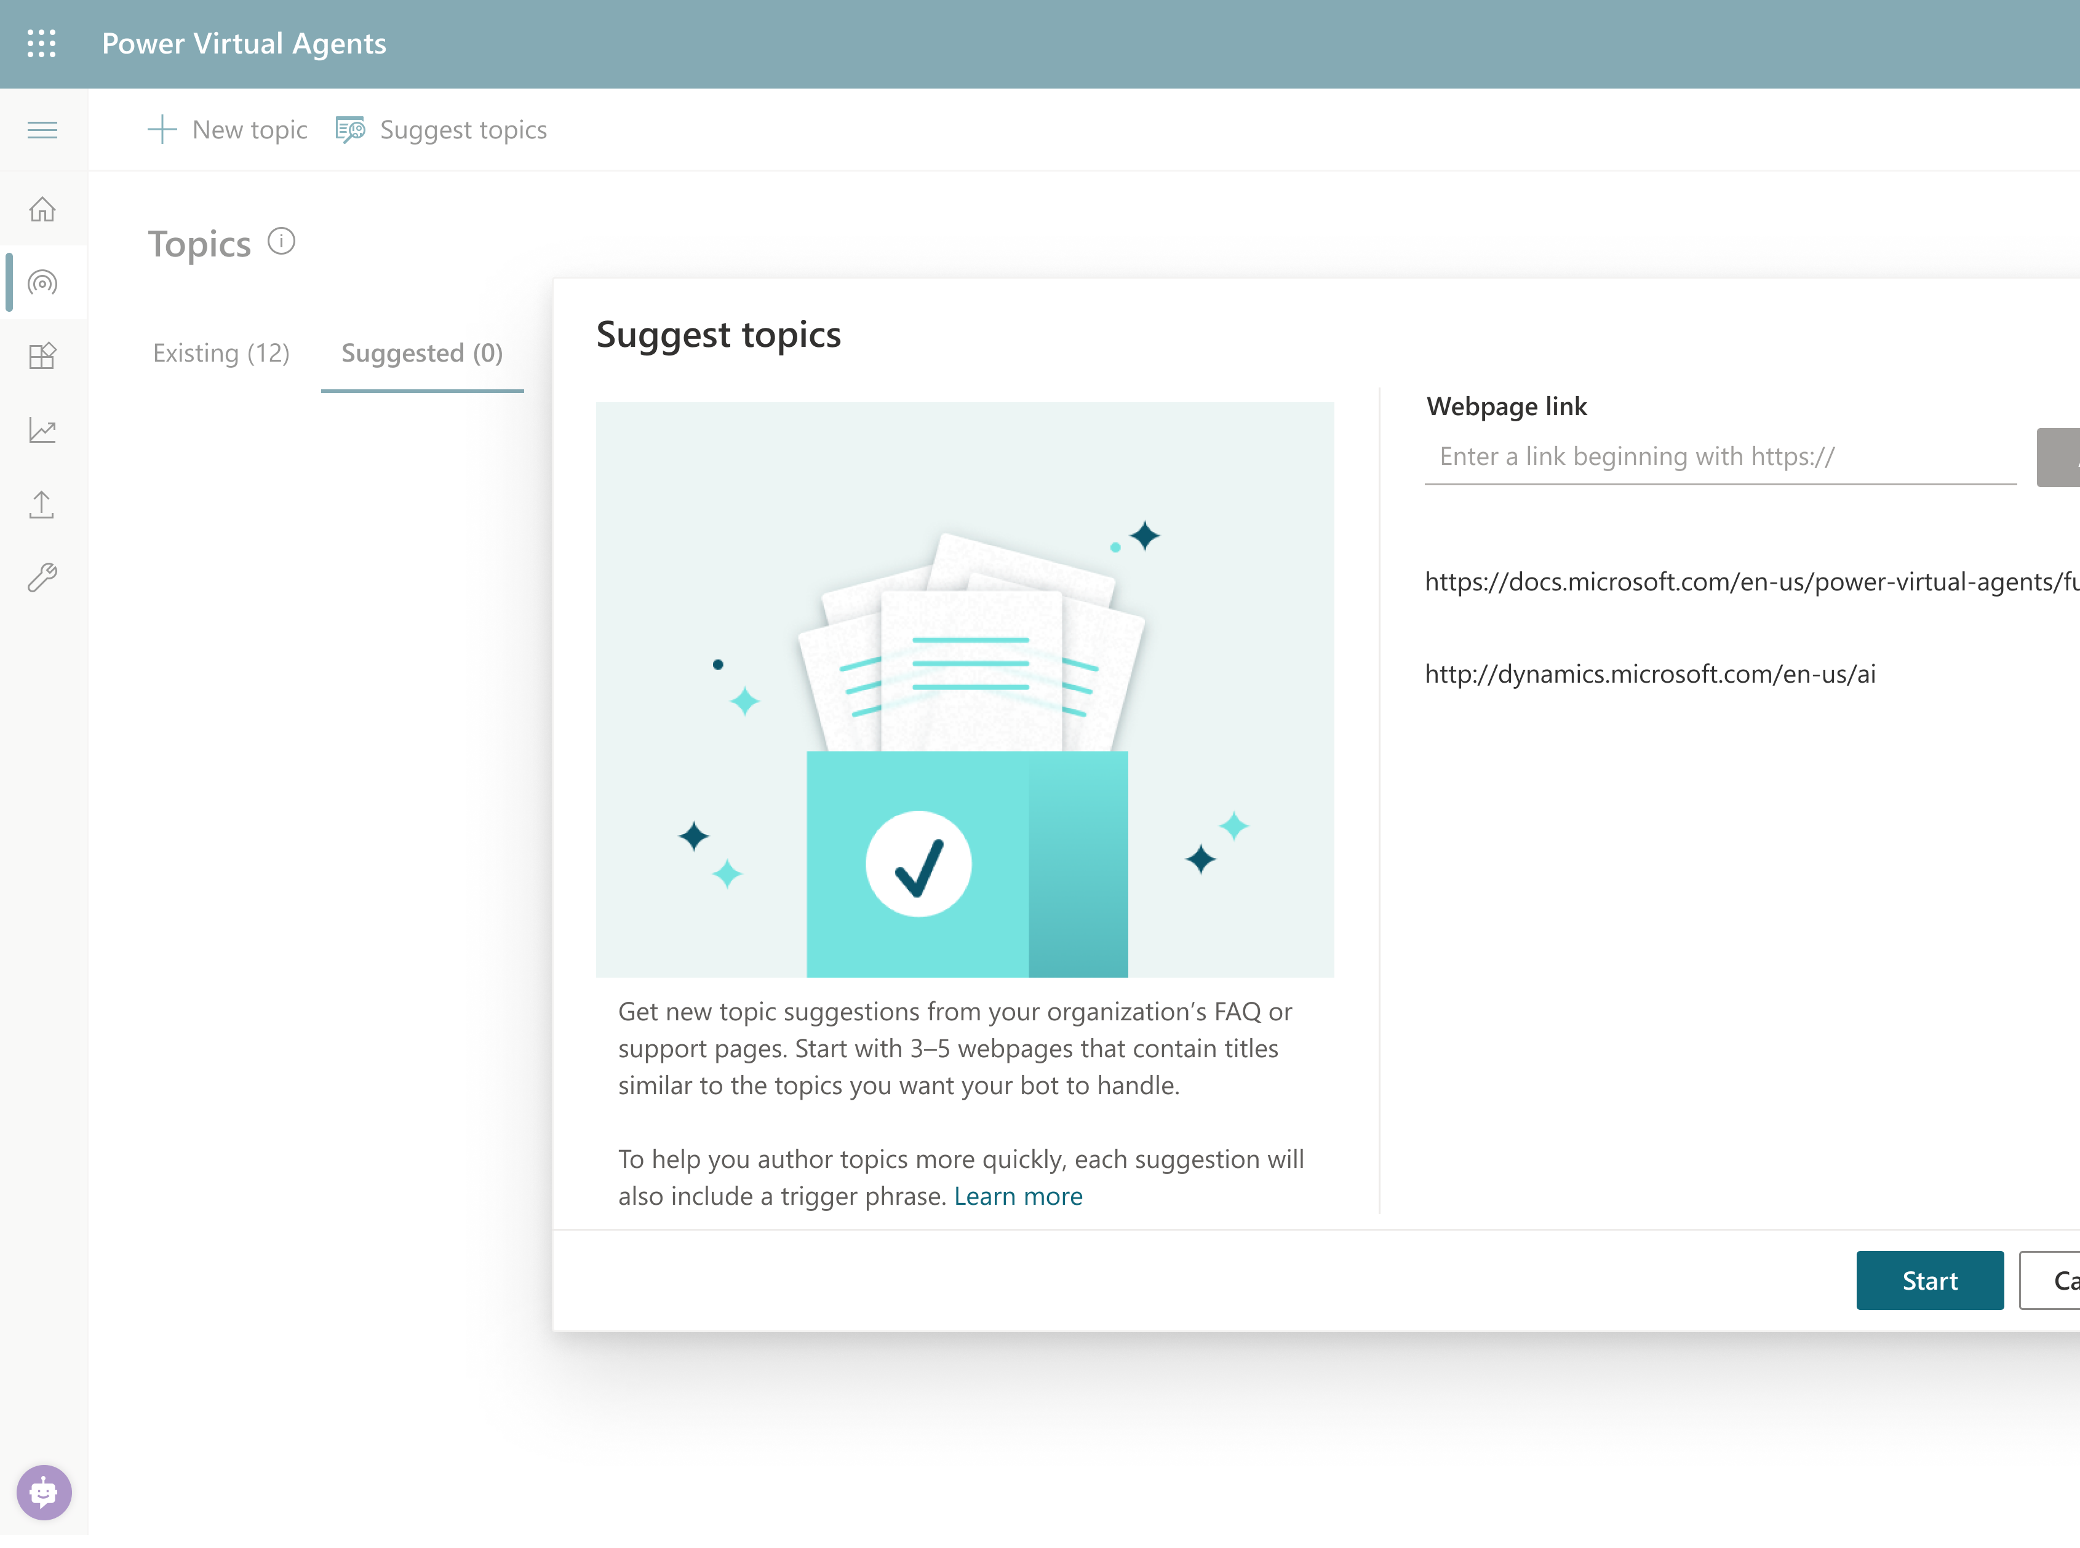
Suggest Topics
Not sure how to start a strong conversation? Let your own resources guide the way.
Take the lead from your website
Just point the bot to your website and it will extract common questions, FAQs, and other information to pre-build topics for you. You’ll be up and running in minutes – right out of the box.

Slide 38
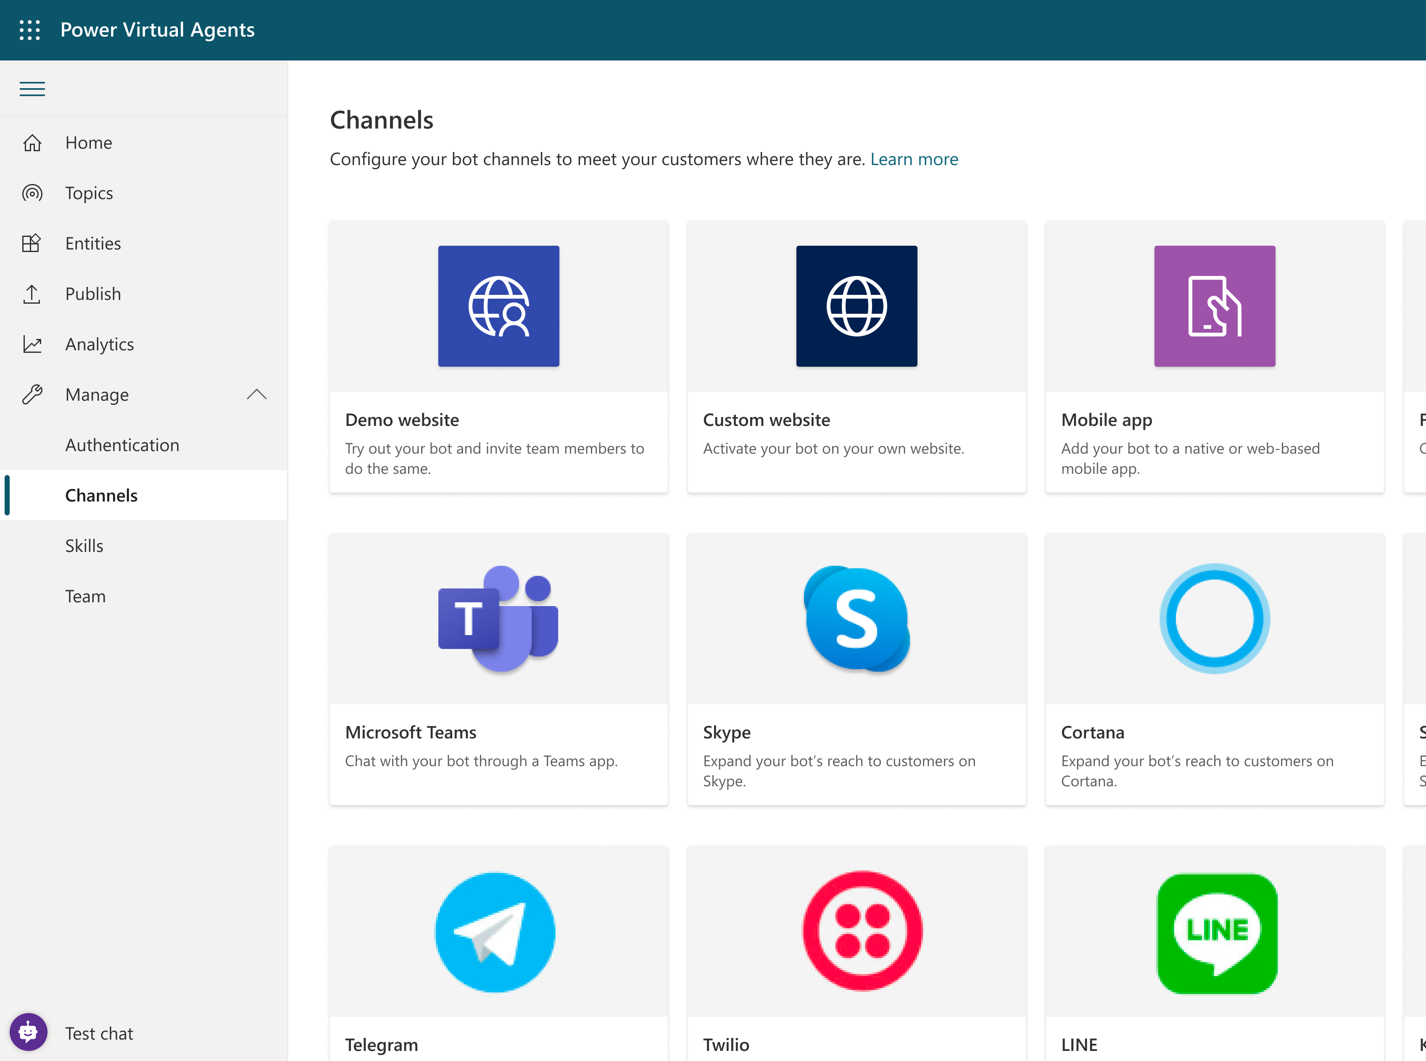
Channels
Every channel is an opportunity. Engage with users wherever they go to find answers, solve problems, or interact with your brand.
Configure and deploy to multiple channels
Easily embed your bot wherever you engage with customers: websites, mobile apps, Facebook, Teams, or any of the dozens of channels supported by Bot Framework.
Deploy to demo sites with a single click
Test and gain feedback by deploying your bot to a demo website and sharing it internally with colleagues—then embed it in your own website when ready.

Slide 39
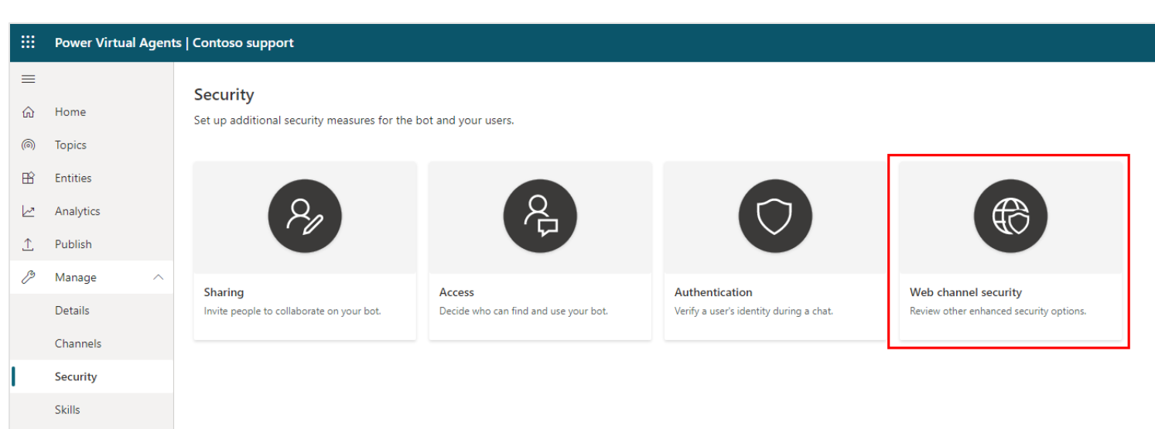
Web Channel Security
When you create a Power Virtual Agents bot, it is immediately available in the Demo website and Custom website channels to anyone who knows the bot ID. These channels are available by default, and no configuration is needed.
Users can find the bot ID directly from within Power Virtual Agents or by receiving it from someone. Depending on the bot's capability and sensitivity that might not be desirable.
With Direct Line-based Web channel security, you can enable access only to locations that you control by enabling secured access with Direct Line secrets or tokens.
You can read more info about this here

Slide 40
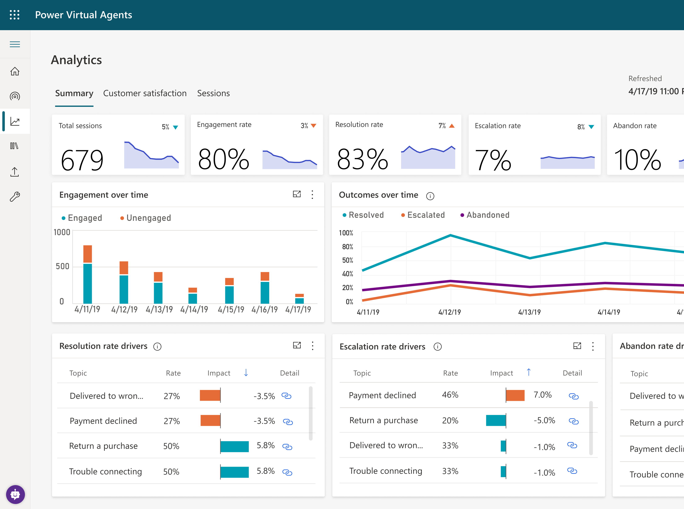
Analytics
Improving the Bot’s topic and treiggering performance is simple. Industry-leading AI makes it possible to improve engagement based on customer awareness and satisfaction.
See what’s working – and what to improve
Analyze your bot’s interactions to better understand how specific topics are performing, learn what’s impacting your CSAT, and identify areas for improvement.
Know what to build next
See which conversations are routing to human agents and determine what topics to teach your bot next.

Slide 41
Summary
PVA bot can leverage the below capabilities to drive business value
Topic generation
Triggering
Entity Extraction
Analytics
Channels

Slide 42
Power Platform Architecture Series
Extend your PVA bot with the Power Platform
presented by

Slide 43
About this series
This series is designed for Architects, Developers and IT Professionals who wish to understand how a Power Virtual Agents solution can be designed and implemented
The content is divided up into separate sessions that build into a complete* architecture
Example materials to follow along with are available here
*Some scenarios, for example integration with Dynamics Omnichannel, are simplified here for brevity

Slide 44
About this session
Chatbot extensibility allows organizations to tap into other systems to derive additional value
This allows your chatbot to transact on behalf of the user which reduces manual work and drives automation opportunities
Organizations can subsequently go after higher-value use cases
We have multiple extensibility options ranging from no-code to pro-code solutions.

Slide 45
Extensibility Options
Power Automate
Bot Framework Composer
Bot Framework Skills
No-code
Low-code
Pro-code

Slide 46
Azure Bot Service
Bot Framework Skill
Bot Framework Skill
Environment
Channels
BF Composer Dialog
BF Composer Dialog
User Topic
SaaS
Web
Entity
Custom
User Topic
Flow
Entity
Custom
User Topic
Entity
Entity
Flow
QnA Maker
Teams
User Topic
Connectors
Entity
Entity
Flow
Entity
Entity
System Topic
Flow
System Topic
Flow
AI Builder
App
Analytics
Solution
Desktop

Slide 47
Power Automate
Power Automate is a no-code SaaS tool that enables automation
Using Power Automate allows us to orchestrate API calls across various systems
As part of your Power Virtual Agents, you get Power Automate entitlement including premium connectors and higher API thresholds.
One of Power Automate’s strengths is its 400+ connectors that are available to be used within the tool
In addition, custom connectors or HTTP calls can be made to cloud-based or on-premises systems
Due to Power Automate’s request-response nature, the design of your flow is very important to avoid blocking customer requests

Slide 48
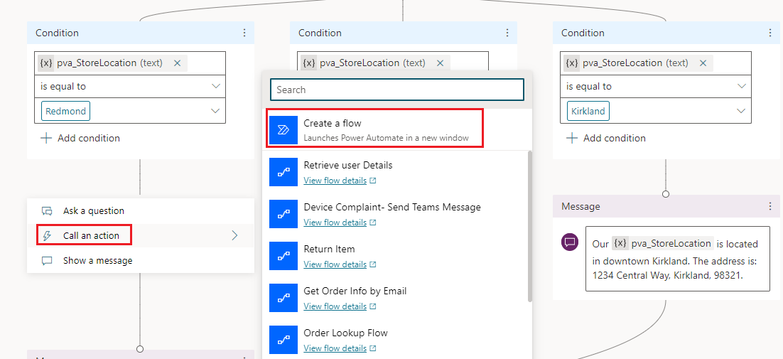
Power Automate
Power Automate Cloud flows surface as ‘actions’
Makers can create a new flow or select an existing flow that resides in a solution and has the PVA trigger
Both inputs and outputs are detected at design time

Slide 49
Azure Bot Service
Bot Framework Skill
Bot Framework Skill
Environment
Channels
BF Composer Dialog
BF Composer Dialog
User Topic
SaaS
Web
Entity
Custom
User Topic
Flow
Entity
Custom
User Topic
Entity
Entity
Flow
QnA Maker
Teams
User Topic
Connectors
Entity
Entity
Flow
Entity
Entity
System Topic
Flow
System Topic
Flow
AI Builder
App
Analytics
Solution
Desktop

Slide 50

Power Automate Help Desk Scenario
Environment
What is the status of my ticket?
My Wi-Fi doesn’t work?
How do I…?
Channels
User Topic
Web
Entity
Custom
User Topic
Flow
Entity
Custom
User Topic
Entity
Entity
Flow
Teams
User Topic
Connectors
Entity
Entity
Flow
Entity
Entity
System Topic
Flow
ServiceNow
System Topic
Flow
App
Analytics
Solution

Slide 51
Tips
By nature, Power Automate works in both synchronous and asynchronous manners
As a result, there may be some features or behaviors that need to be tuned to better address chatbot scenarios
Always important to remember the experience of the chatbot user who is waiting for an action to take place.

Slide 52
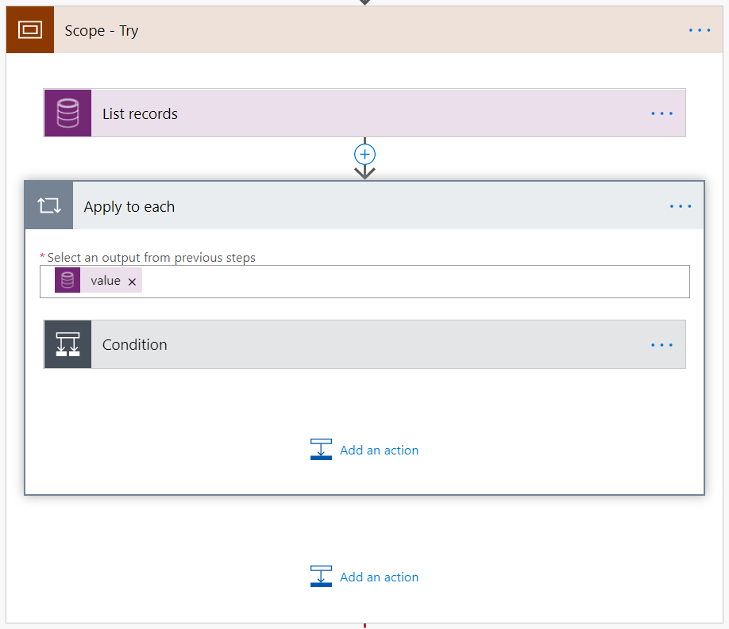
Avoid Looping
Use Filters
First() expression

Slide 53
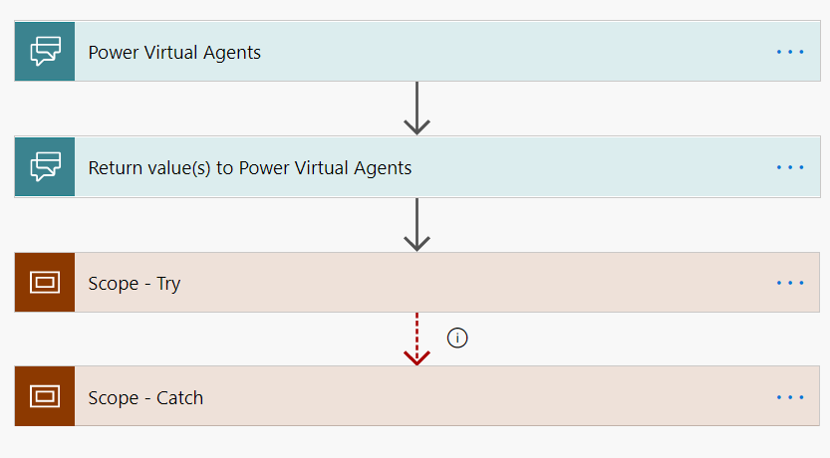
Don’t Unnecessarily Block Caller
When possible, return control back to PVA and process additional flow actions after Return Value action

Slide 54
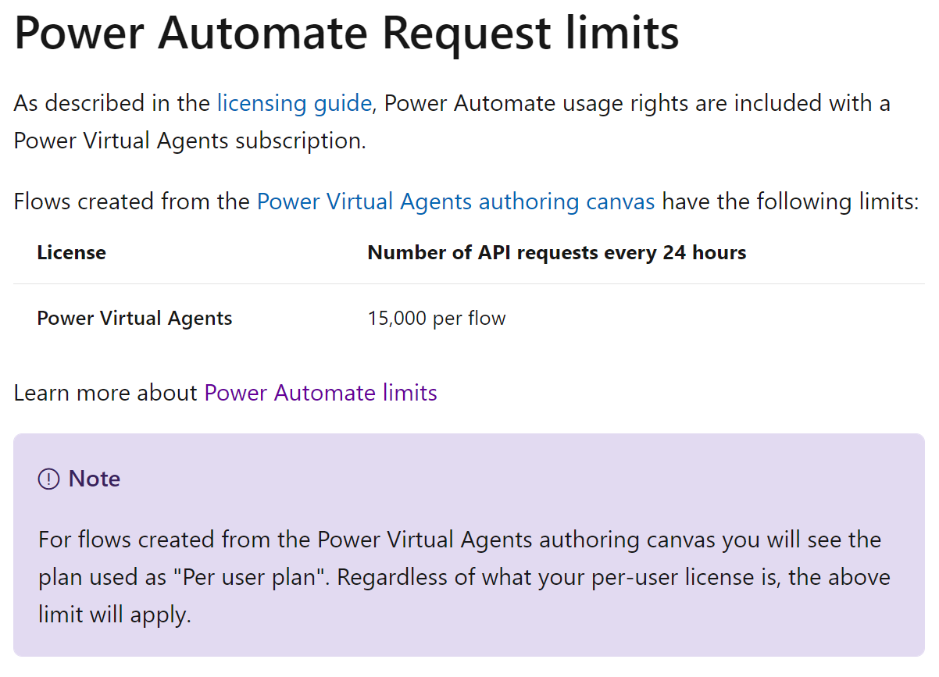
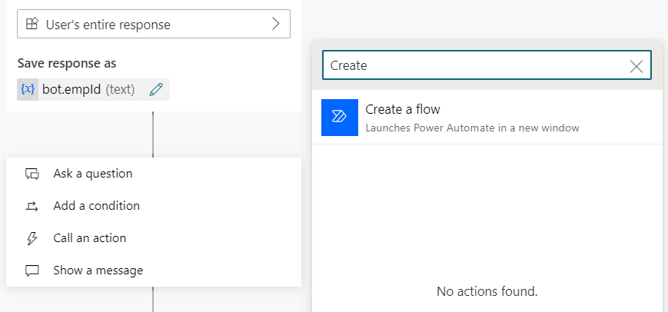
Always Create Flows from Power Virtual Agent Template
https://docs.microsoft.com/en-us/power-virtual-agents/requirements-quotas

Slide 55
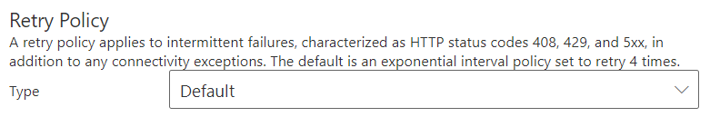
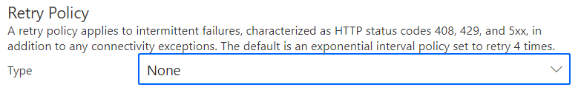
Fail Fast - Disable Retries

Slide 56
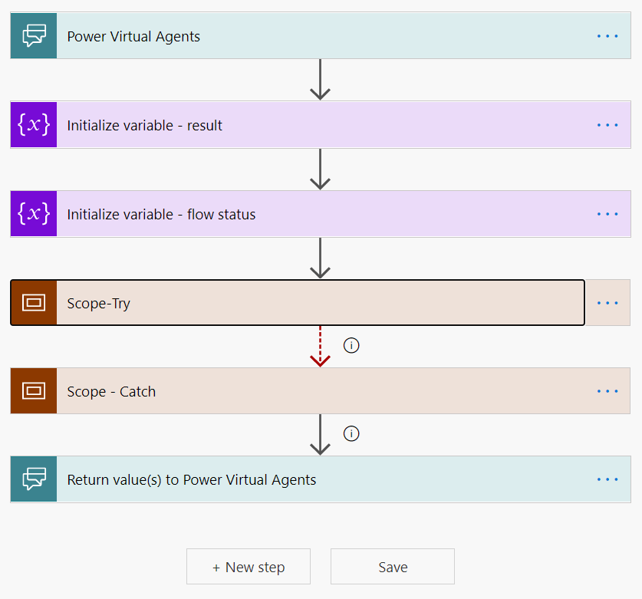
Exception Handling
Don’t throw unhandled exceptions back to PVA
PVA will display unfriendly error message
Use Scopes and Configure Run After Settings to implement ‘Try-Catch’ semantics.

Slide 57
AI Builder
Power Virtual Agents includes AI through the Natural Language Understanding (NLU) capabilities
Additional AI use cases can be unlocked using AI Builder
Much like the Power Platform democratizes many functions (app building), AI Builder democratizes AI for makers
AI Builder’s functionality is exposed through connectors in Power Automate

Slide 58

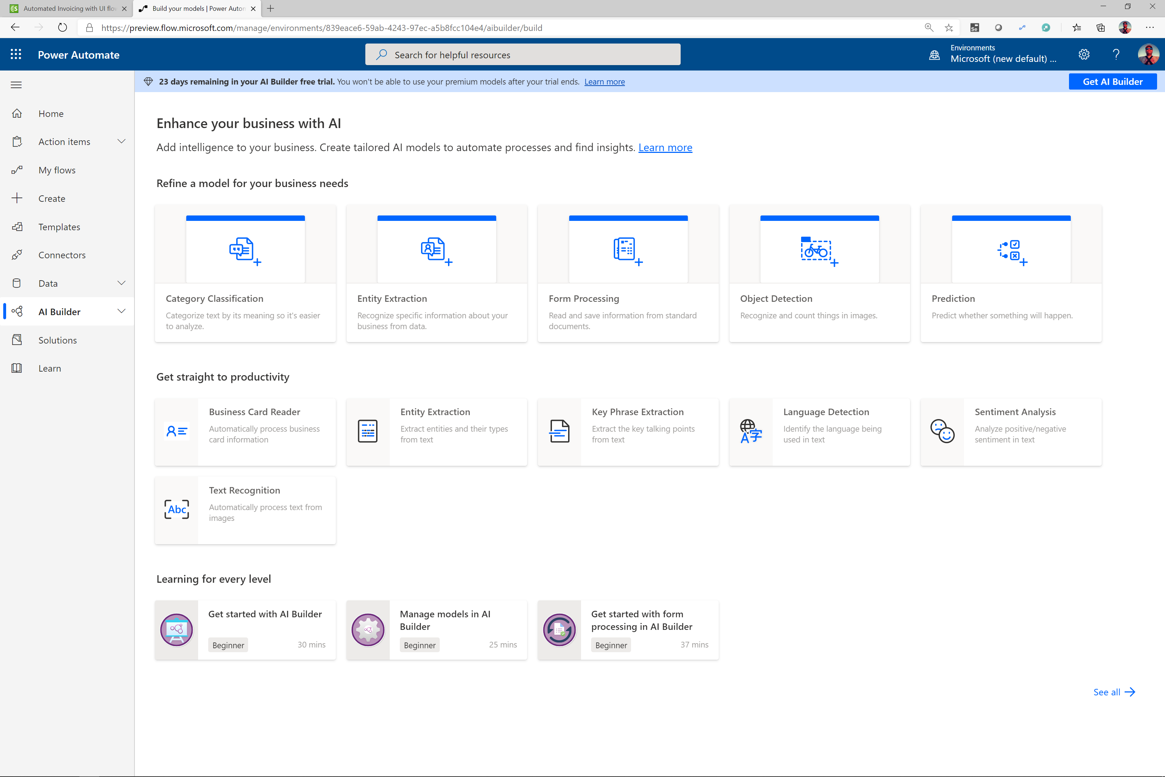
Enhance Automation with the Power of AI
Leveraging AI Builder
No-code AI
AI for many industry scenarios
AI for multiple industry vertical

Slide 59
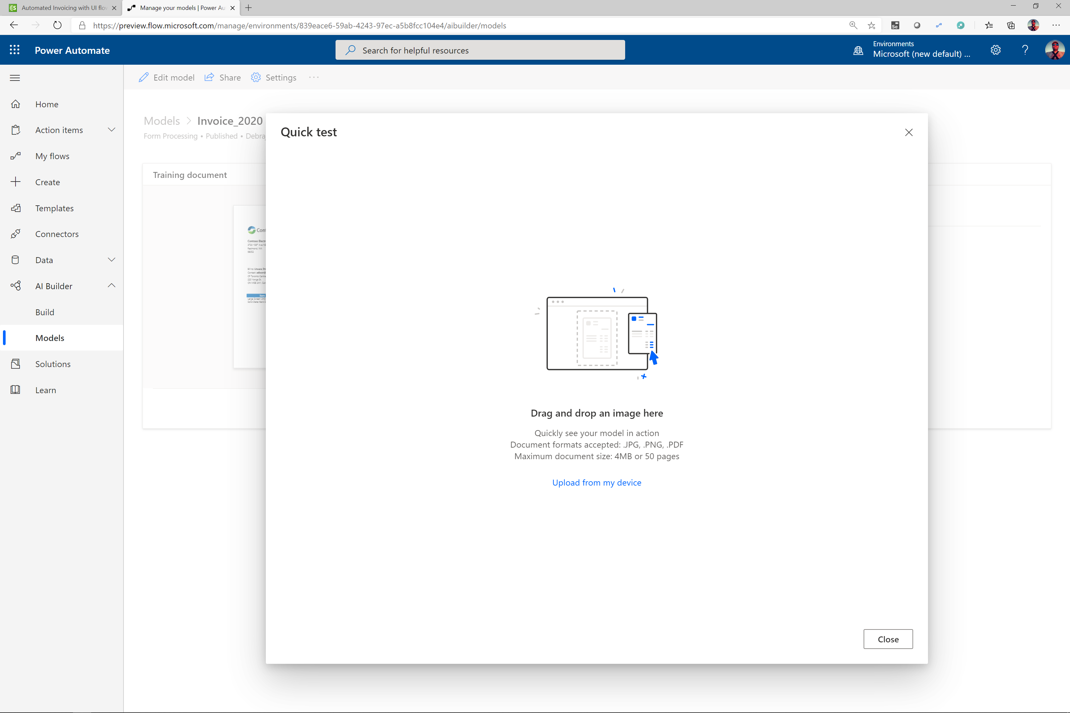
Enhance Automation with the Power of AI
Use Powerful Pre-defined AI Models
Pre-defined models
Create Custom Models
Integrate to any Power Automate

Slide 60

QnA Maker & PVA
QnA Maker, part of Azure Cognitive Services, allows customers to create bots leveraging existing assets e.g.: knowledge bases, product manuals etc.
Customers often use PVA with QnA Maker, PVA delivering multi-turn content and process automation, QnA maker delivering FAQ/KB question-answer pairs.
To integrate, implement PVA’s Fallback topic, and call out to QnA Maker using the Power Automate connector.
For new implementations, assess whether PVA’s Suggested Topics or QnA Maker best serve your needs.

Slide 61
Power Automate Desktop
Power Automate Desktop allows you to common/repetitive desktop processes.
Those automations can be run unattended and triggered by Power Automate in the cloud.
A common pattern is to take a manual business process, and through a combination of PVA, Power Automate and Power Automate desktop, automate it completely through a bot
Note: RPA processes tend to be long running so you do want to be careful not to block your user and generate timeouts. Use Power Automate and adaptive cards to asynchronously sent them messages.

Slide 62






PVA +Power Automate Desktop
Customer
Paper form
Post
Agent
Desktop PC
Database
Customer
Power Virtual Agents
Power Automate Cloud Flow
Power Automate Desktop Flow
Desktop PC
Database

Slide 63
Summary
The wider Power Platform has a great extensibility story with Power Virtual Agents.
Power Automate connector library can easily connect your bot into line of business SaaS systems.
Know the tips to make best use of Power Automate when building extensibility.
Connect to AI Builder, QnA Maker or Power Automate Desktop to deliver even more use cases.

Slide 64
Power Platform Architecture Series
Extend your bot with Azure
presented by

Slide 65
About this series
This series is designed for Architects, Developers and IT Professionals who wish to understand how a Power Virtual Agents solution can be designed and implemented
The content is divided up into separate sessions that build into a complete* architecture
Example materials to follow along with are available here
*Some scenarios, for example integration with Dynamics Omnichannel, are simplified here for brevity

Slide 66
About this session
Many customer use cases can be built in PVA using topics, entities and Power Automate
For more complex scenarios, integrating with Azure Bot Framework can provide flexible pro-dev solution to implement advanced conversation flows.
This session also demonstrates integration patterns for leveraging other backend Azure services.

Slide 67
Azure Bot Service
Bot Framework Skill
Bot Framework Skill
Channels
BF Composer Dialog
BF Composer Dialog
User Topic
SaaS
Web
Entity
Custom
User Topic
Flow
Entity
Custom
User Topic
Entity
Entity
Flow
QnA Maker
Teams
User Topic
Connectors
Entity
Entity
Flow
Entity
Entity
System Topic
Flow
System Topic
Flow
AI Builder
App
Analytics
Desktop

Slide 68
Extensibility Options
Power Automate
Bot Framework Composer
Bot Framework Skills
No-code
Low-code
Pro-code

Slide 69
Extensibility Options
Power Automate
Maintains Power Platform low-code experience
Use huge library of connectors
Bot Framework Composer
Pro-dev low-code experience
Custom tooling running on desktop
Bot Framework Skills
Pro-dev code experience
Built using IDE (e.g. Visual Studio)
Runs in Power Automate process
Backend integration: yes
Dialog control: no
ALM using Solutions
Latency: higher
Runs in Power Virtual Agents process
ALM using Solutions
Backend integration: yes
Dialog control: yes
Latency: lower
Runs in Azure Bot Service (independently scaleable, additional cost)
ALM is developer's choice (e.g GitHub, Azure DevOps
Backend integration: yes
Dialog control: yes
Latency: lower
AI engine: PVA
AI engine: PVA
AI engine: custom (e.g. LUIS)

Slide 70

Extensibility Options
Generally, if unsure always start with PVA + Power Automate
Development is fast, you will work out if it meets the needs of your scenario quickly
Bot Framework Composer works great for:
Complex dialog layouts (e.g. adaptive cards)
Conversation mechanics not supported through standard PVA
BFC has a longer learning curve than PVA – it is an accelerator for Pro Dev
Bot framework skills have the greatest level of flexibility, but generally take the longest to create
Good for implementing features that are highly reusable across multiple bots
For implementing bot features that require pro code features e.g. custom authentication
Skills are managed and scaled separately
Skills need to use a 3rd party NLU model (e.g. LUIS)
Lower latency than Power Automate for complex, reused functions.

Slide 71
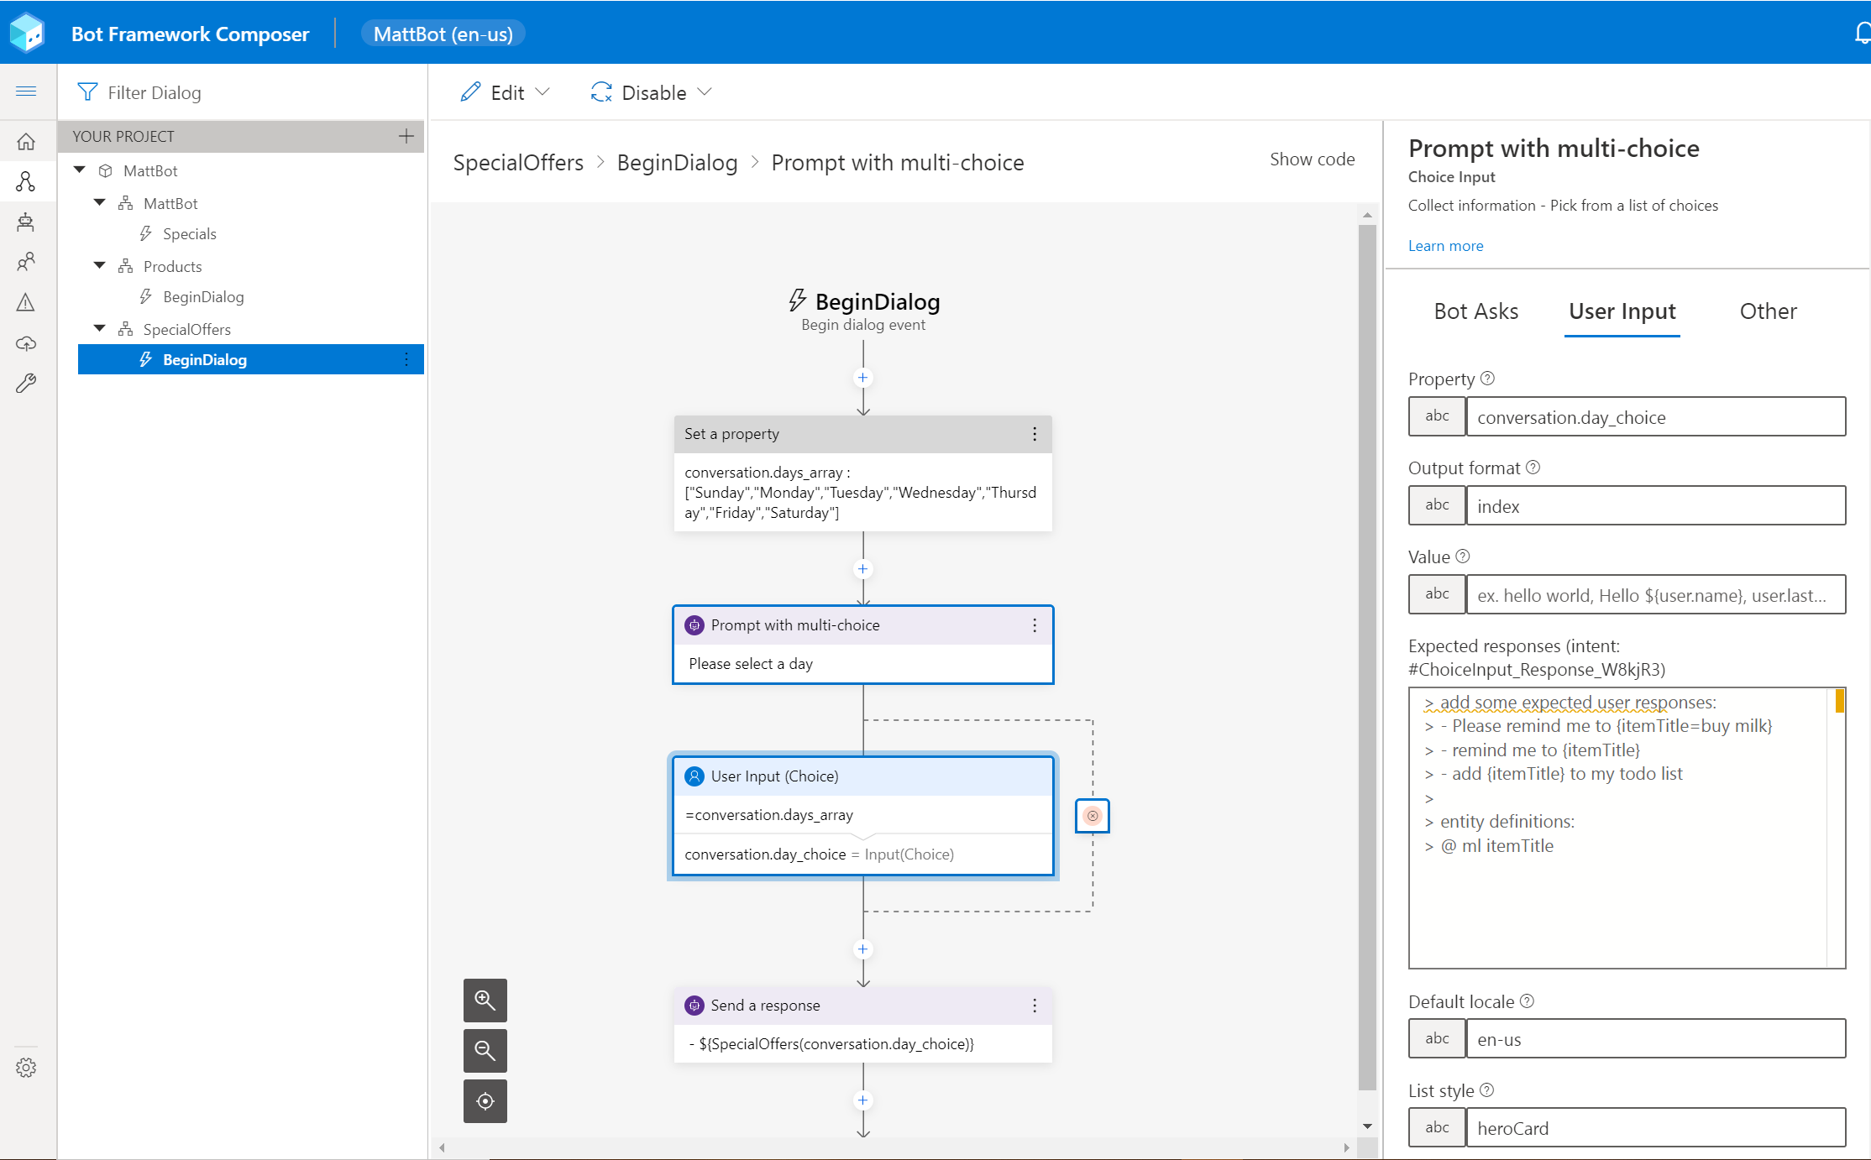
Bot Framework Composer
Provides a low-code, pro developer experience
More flexible and configurable than the PVA topic designer
More complex with larger learning curve than PVA + Power Automate
Use to create complex dialogs, adaptive cards
Add complex branching/looping to conversations
Send multiple responses
Validating complex inputs (e.g., ID numbers)
Call external http endpoints, emit events

Slide 72
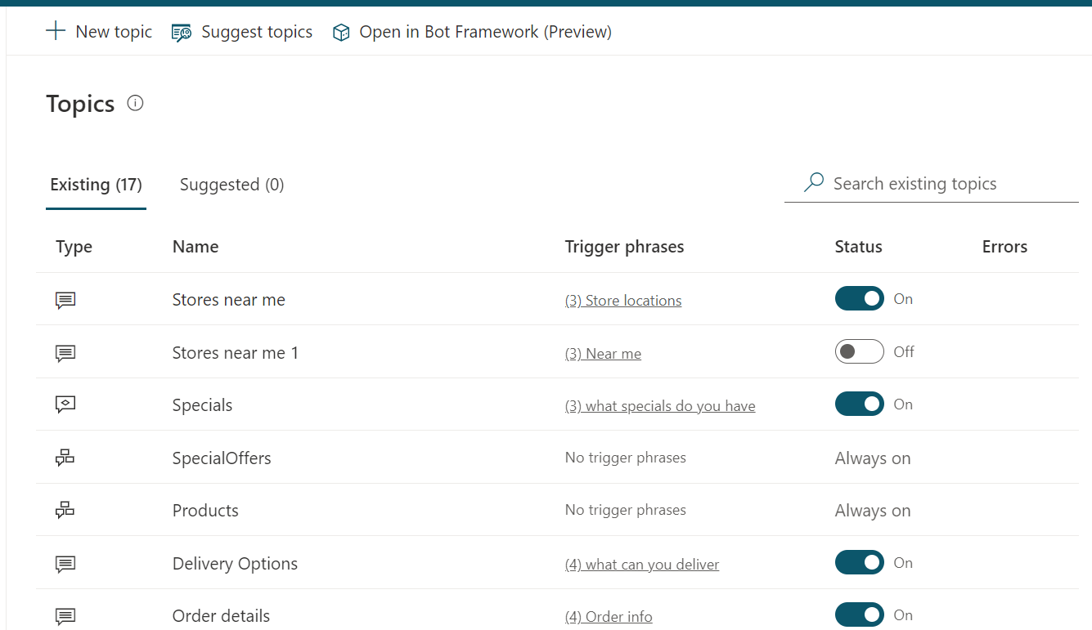
Bot Framework Composer in PVA
Start BFC session
To use BFC with PVA, a session should always be started from PVA (adding existing BFC to PVA not currently supported)
BFC topics are triggered from a PVA topic (so you will generally have a PVA topic with the trigger phrases, and a topic for the BFC dialog
BFC topics use the PVA AI model (no need for LUIS)
PVA topic & BFC topic

Slide 73
Managing Bot Framework Composer & PVA
Creating a Bot Framework Composer topic from PVA ensures that composer topics ship with PVA as part of solutions
BFC topics run in the PVA process - managed and secured as part of PVA
BFC changes must be published in the BFC designer to take effect!
Currently, using Composer with PVA, you must always use the ‘Default Recognizer’ (i.e. PVA recognizer) – this means you will take advantage of PVA’s built-in AI model.

Slide 74
Demo: Bot Framework Composer & PVA

Slide 75

Bot Framework Skills
The Azure Bot Framework is an SDK and toolset allowing pro-devs to build and manage bots.
Bot Framework Skills are reusable bot components that can be incorporated into a bot.
Power Virtual Agents is built upon the Azure Bot Framework. It can use Bot Framework skills as extensible components.
Bot Framework skills are best used for complex scenarios where high-levels of control and customization are needed.

Slide 76
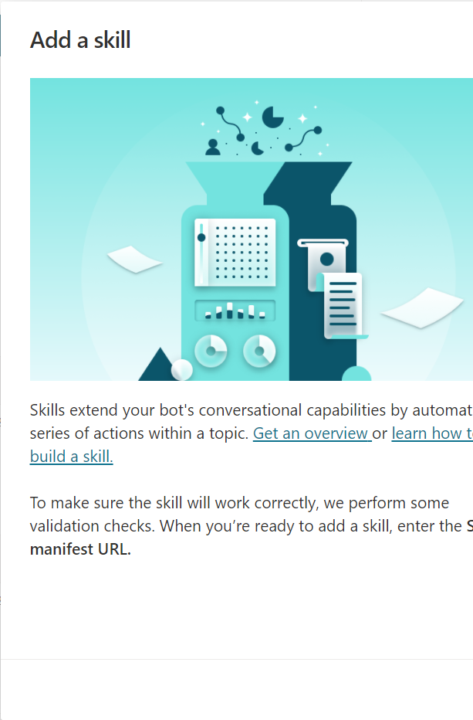
Building a skill for PVA
Skills talk to bots through a Manifest. This is a JSON interface specification like an Open API definition. It documents the identifiers of the bot, it’s inputs, outputs and types.
When setting up a skill, PVA will import and validate that the manifest meets its requirements
If creating a new skill for use with PVA, it is highly recommended to define the Manifest of your skill first with a mocked/simple bot implementation. Once your interface imports successfully, the bot implementation can be defined.
Once imported, your skill can be used within a PVA topic.

Slide 77

Azure Bot Service
Bot Framework bots can be run locally (using Bot Framework emulator) for development, but for testing/production they are (usually) deployed to Azure Bot Service
Azure Bot Service is a purpose-built Azure resource for running Bot Framework bots
The service runs on top of Azure App Service and supports the scalability & flexibility of this service.
When creating a skill, architects should factor in that separate security and management of the skill running in Azure Bot Service will be needed.

Slide 78

Secure your skill
Skills are secured with an Azure Active Directory App Registration. Generate a client ID and secret and add them to appsettings.json
Also ensure your skill can be called by all the PVA, by adding the ID of your PVA bots to the “AllowedCallers” section of appsettings.json. Get these values from the “Provide ID for allow list” button on the skills screen in PVA.
Beware of the ‘same tenant restriction’ – the PVA user must have access to the Azure tenant where the Skill App Registration resides.

Slide 79

Preparing your manifest
Manifests must adhere to PVA requirements for skills. These are:
You may declare only 25 or fewer actions.
Each action is limited to 25 or fewer inputs or outputs.
You cannot use the array type for inputs or outputs.
Consider here what variables you can gather from PVA for input, and what PVA needs as return values.
Build a base manifest, test it in PVA to confirm it works, then iterate.
Details of the manifest schema, and a tutorial for building out a skill, available on GitHub.

Slide 80

Implement your skill
Build a simple bot first and test it through the emulator and in PVA before implementing complex code.
Use a class implementation for all inputs/outputs defined in the manifest – ensuring the members in the class are marked as JsonProperty matching their definition in the manifest.
Regularly test your bot as you develop!
Example skill projects are available through GitHub

Slide 81
Demo: Bot Framework Skills

Slide 82
Other Azure Services
Connecting to other services (whether in Azure or elsewhere) for backend processing whether doing so through Power Automate, Bot Framework Composer or through Skills, is generally done through HTTP APIs.
A good architectural practice is to front those APIs with an API Gateway e.g., Azure API Management.
PVA can call these using Power Automate (HTTP or custom connector), BFC can create HTTP requests, and BF skills can create HTTP requests in code
Another approach: use the On Premises Data Gateway to connect in to resources

Slide 83






Azure Bot Service
Bot Framework Skill
Bot Framework Skill
Channels
BF Composer Dialog
BF Composer Dialog
User Topic
SaaS
Web
Entity
Custom
User Topic
Flow
Entity
Custom
User Topic
Entity
Entity
Flow
QnA Maker
Teams
User Topic
Connectors
Entity
Entity
Flow
Entity
Entity
System Topic
Flow
System Topic
Flow
AI Builder
App
Analytics
Desktop

Slide 84
Azure Bot Service
Bot Framework Skill
Bot Framework Skill
Channels
BF Composer Dialog
BF Composer Dialog
User Topic
Web
Entity
Custom
User Topic
Flow
Entity
Custom
User Topic
Entity
Entity
Flow
Teams
User Topic
Connectors
Entity
Entity
Flow
Entity
Entity
System Topic
Flow
System Topic
Flow
App
Analytics

Slide 85
Summary
When creating extensibility for Power Virtual Agents, it is important to understand the pros/cons of each approach
If in doubt, start with Power Automate as the simplest approach
Integration to a wider range of computing systems can be achieved using the API Gateway pattern.

Slide 86
Power Platform Architecture Series
Advanced topics
presented by

Slide 87
About this series
This series is designed for Architects, Developers and IT Professionals who wish to understand how a Power Virtual Agents solution can be designed and implemented
The content is divided up into separate sessions that build into a complete* architecture
Example materials to follow along with are available here
*Some scenarios, for example integration with Dynamics Omnichannel, are simplified here for brevity

Slide 88
About this session
This sessions covers some of the advanced topics of working with PVA. Understanding these topics will help architects to understand complexity and mitigate risk in their implementation of PVA.

Slide 89
Azure Bot Service
Bot Framework Skill
Azure Active Directory
Bot Framework Skill
Omnichannel for Customer Service
Environment
Channels
BF Composer Dialog
BF Composer Dialog
Escalate
User Topic
SaaS
Web
Entity
Custom
User Topic
Flow
Entity
Custom
User Topic
Entity
Entity
Flow
QnA Maker
Teams
User Topic
Connectors
Entity
Entity
Flow
Entity
Entity
System Topic
Flow
System Topic
Flow
AI Builder
App
Analytics
Solution
Desktop
RBAC
Microsoft Dataverse
ALM

Slide 90
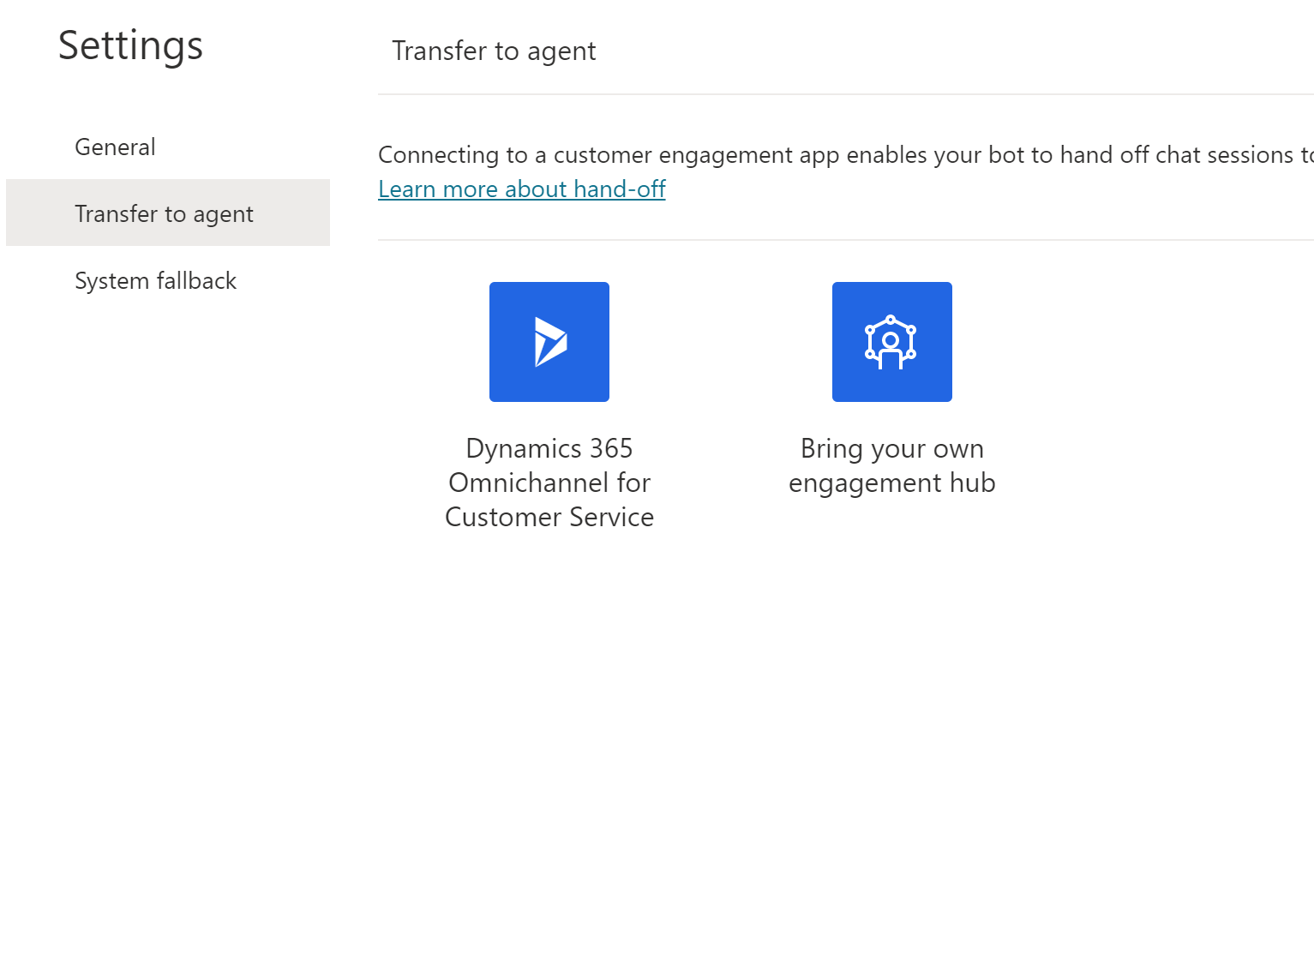
Omnichannel for Customer Service
Power Virtual Agents plays well with human agents in Omnichannel. Together, they provide the seamless agent transfer experience for your users in the same canvas.
Out of the box, Power Virtual Agents comes configured to work with Dynamics 365 Omnichannel for Customer Service. When the bot can’t help, it pulls in a human automatically.
PVA can also be configured to work with other engagement hub solutions. This may involve pro-developer work to achieve. Configure hand off to a generic engagement hub

Slide 91
PVA + Omnichannel Considerations
Styling and rendering using Omni-channel canvas (Live-chat widget vs SDK)
Deploying PVA to Asynchronous Channels through OC + Twilio (e.g. WhatsApp)
Attachment handling in PVA using Omni-channel
E2E Load testing for PVA + OC stack including Agent Escalation
1-1 connection – PVA bot can talk to only one OC instance at a given time
Upcoming:
End of Conversation time outs after inactivity (30mins) to remove from active OC queue list

Slide 92
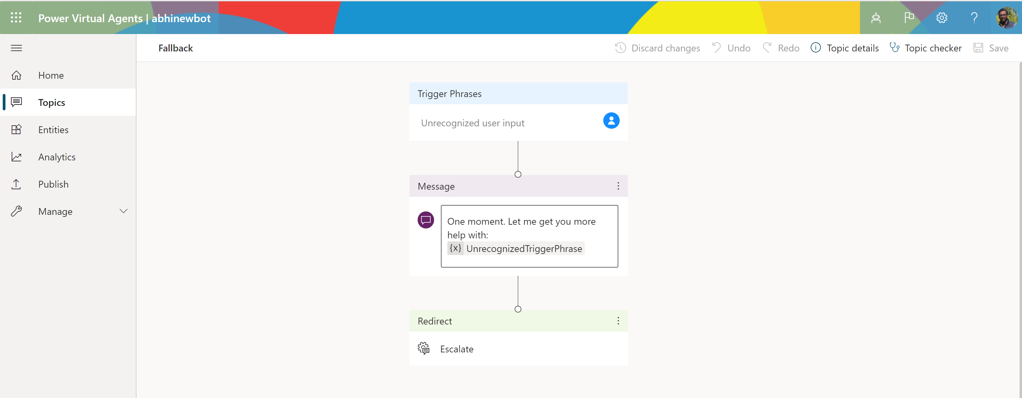
Fallback topic
Fallback topic to the system topics list and allows customization when the user intent is not triggering a user or system topic.
This topic can be edited, call actions from external services such as Bot Framework and Power Automate, or redirect to another topic.

Slide 93
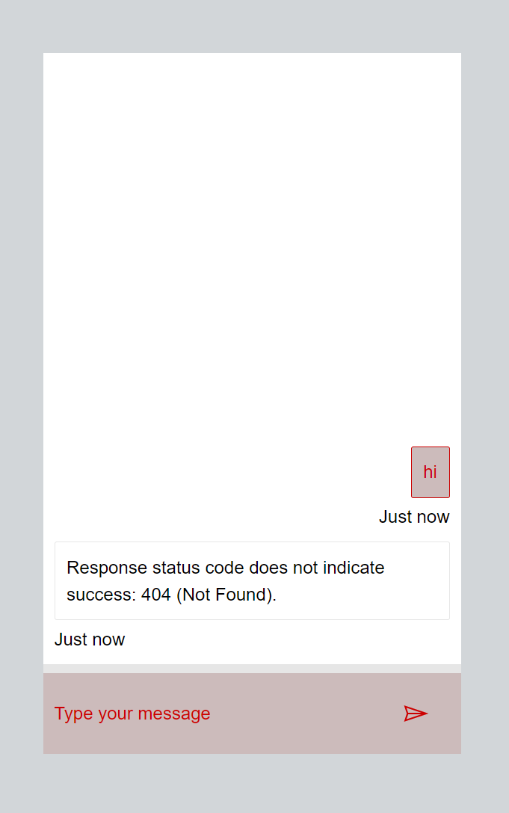
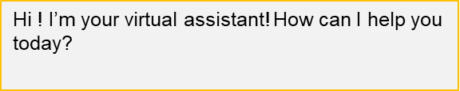
Custom canvas
User can customize the default canvas with JavaScript-based styling in the HTML code for the website where you deploy your bot. Customizing the default canvas is useful if you want to make small customizations without investing in code development.
User can use a custom canvas, based on the Bot Framework Web Chat canvas. Connecting to a custom canvas requires extensive developer knowledge and is useful for organizations that want to customize the experience completely.
Use the web chat canvas editor tool to quickly test out your styles – keeping to available stylesheet options makes the job simpler!
You can find more info about canvas styling here

Slide 94
Single sign-on
Single sign-on provides a seamless experience, allowing the bot to use the user’s credentials
Single sign-on can be configured simply using the PVA portal for internal/B2E scenarios where Azure Active Directory (not AAD B2C) is the identity provider.
For external/B2C/non-AAD scenarios, a custom solution is needed currently (guidance & sample code available soon)

Slide 95
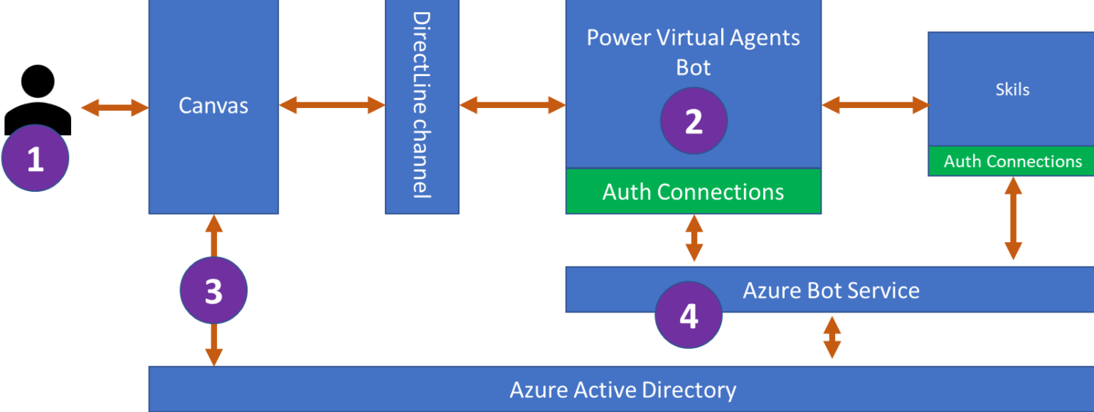
Single sign-on (internal/B2E)
The bot user enters a phrase that triggers a sign-in topic. The sign-in topic is designed to sign the user in and use the user's authenticated token (AuthToken variable).
Power Virtual Agents sends a login prompt to allow the user to sign in with their configured identity provider.
The bot's custom canvas intercepts the sign-in prompt and requests an on-behalf-of (OBO) token from Azure AD. The canvas sends the token to the bot.
On receipt of the OBO token, the bot exchanges the OBO token for an "access token" and fills in the AuthToken variable using the access token's value. The IsLoggedIn variable is also set at this time.
You can find more info here

Slide 96



Single sign-on (external/B2C)
Private Key
Public Key
3. Website lets authenticated user into site. It requests a new JWT token encrypted with private key from key service and returns that to the user's client.
OAuth 2 IDP
Website
PVA
Bot Framework Skill
5. The skill connected to PVA validates the JWT token by pulling in the public key and returning to PVA a User ID from the JWT claim.
2. User provides credentials to log in, and receives token
4. User’s client makes call to create PVA using custom canvas. The global external variable, ‘token’ is set to the JWT using pvaSetContext
6. To authenticate, a PVA topic needs to use the Global Variable ‘UserID’ in a topic.
1. User browses to secured website and is redirected to log in.

Slide 97
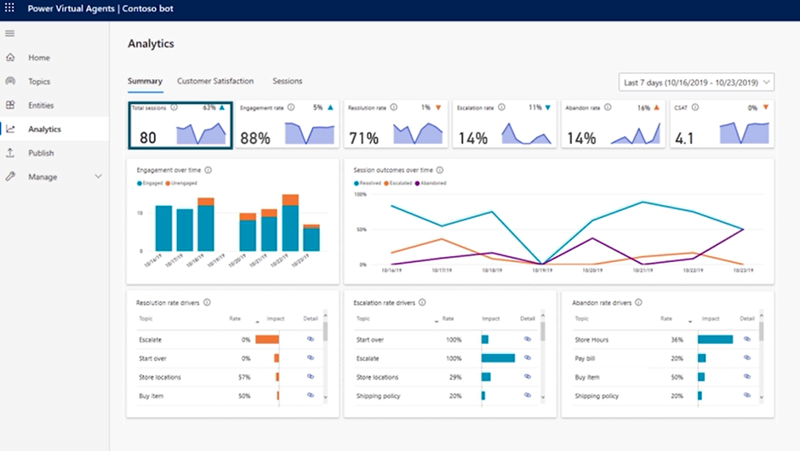
Advanced analytics
The Advanced analytics provides you multiple ways to understand bot performance beyond the out of box Analytics Dashboards in PVA.
The analytics dashboards are updated every hour, so there will be some delay before you see all data, however transcripts are available immediately.
The Augmented Transcripts help you to extract additional data directly from Dataverse for measuring Bot performance and build your own custom dashboards specific to your organization’s needs
Custom analytics solution: http://aka.ms/pvaanalytics

Slide 98
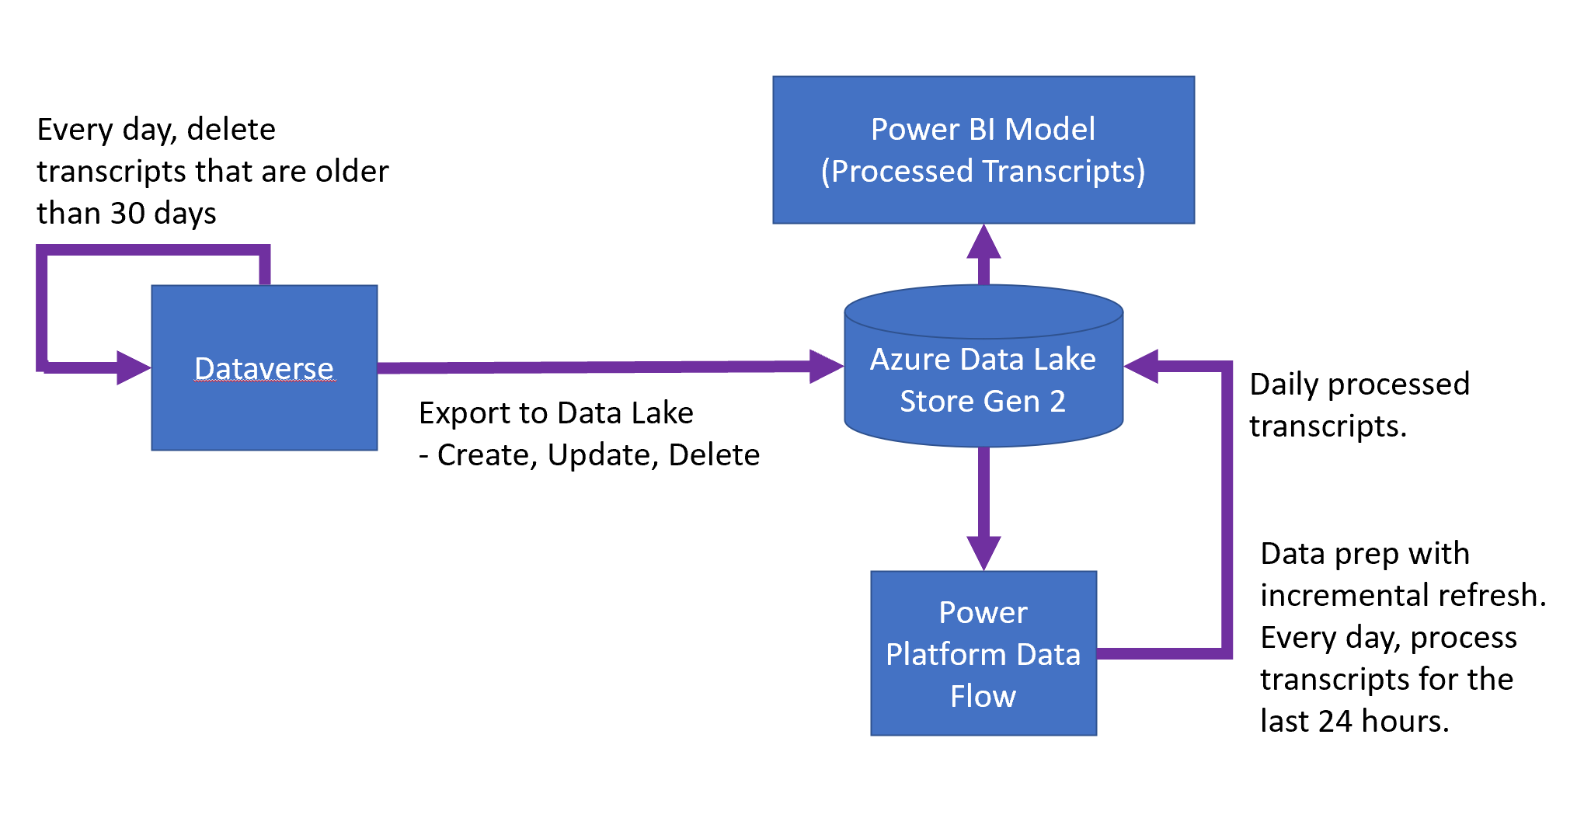
Advanced Analytics Playbook
Identify a set of custom dashboards based on your business requirements and the insights from custom dashboard samples from CoE tool kit, complete the wireframes
Set up db schemas to store metrics based on your wireframe design
Build the .pbix to connect to sample db schemas, for the custom dashboards
Set up the processing pipeline (advanced enterprise scenarios):
Set up export and back up of transcripts using Data Lake
Set up data processing jobs in Power Platform Data Flow or Data factory
Parse most relevant custom metrics for your dashboard
You can refer to more info on playbook and sample code here

Slide 99
Simple data dictionary
# | Name | Description
 | Conversationtranscript | Unique identifier for conversation entity instances
 | bot_conversationtranscript | Conversation Transcripts related to customer interactions with a Bot
 | Name | The name of the custom entity. (conversationid followed by botid)
 | Created on | Date and time when the record was created.
 | Content | Contains Transcript JSONS
 | Metadata | Contains Metadata JSONS
 | ConversationStartTime | The actual start time of the conversation (not the time it was written to the data store)
ConversationTranscript

Slide 100
Simple data dictionary
# | Name | Description
 | Id | Holds unique guid to identify the activity object.
 | valueType | Indicator of the type of value stored in activity, this dictates what information is being provided by this activity (IntentRecognition, Handoff, IntentCandidates, ImpliedSuccess, SessionInfo, ConversationInfo, VariableAssignment)
 | timestamp | Timestamp of when activity was generated in epoch
 | type | Indicator of the type of activity (ex. message, event, trace)
 | replyToId | Field linking activities together, holds the id of the activity that current activity is responding to
 | from | Contains fields “id” and “role” which stores the id of the invoker and role holds 0 or 1 (0 – activity is coming from bot, 1 – activity is coming from c2 user)
 | channelId | Contains the channel id of where activity is coming from (ex. directline)
 | textFormat | Format of the text (ex. plain)
 | attachments | Holds any sort of dynamic rich data associated with activity (ex. AdaptiveCards, HeroCards, Carousal data is all stored in attachments)
 | text | Contains the text for message activities.
 | value | Contains fields specific to activity based off value type, this is where most useful information exists (refer to sample transcripts for context)
 | channeldata | Contains channel data such as DialogTraceDetail, DialogErrorDetail, VariableDetail (VariableAssignments has more descriptive version of this) and CurrentMessageDetail for message. For events contains cci_trace_id, traceHistory, enableDiagnostics, clientTimestamp, clientActivityId.
 | name | Contains the name of the event activity (ex. SetPVAContext)
ConversationTranscript
Content (JSON column)

Slide 101
Simple data dictionary
# | Name | Description
 | BotId | ID of the bot that the conversation entry is coming from
 | AADTenantId | ID of the tenant that the conversation entry is coming from
 | BotName | Name of the bot that the conversation entry is coming from
ConversationTranscript
Metadata (JSON column)

Slide 102
Sample transcripts
{
"valueType": "IntentRecognition",
"id": "07425350369244079f8c5b9326142707",
"type": "trace",
"timestamp": 1609159803,
"from": {
"id": "4ff169d3-62a1-0f9d-0399-bede5aefbcdf",
"role": 0
},
"channelId": null,
"attachments": [],
"replyToId": "UO08fkburIDd6ulH3zPGv-j|0000000",
"value": {
"intentId": "new_topic_9186cfbc77064d319068e183d33e63cd",
"intentScore": {
"score": 1.0,
"Type": 1,
"Title": "Test topic with skill, auth and flow"
},
"triggerUtterance": "test",
"normalizedTriggerUtterance": "test"
}
},
Sample transcripts help you to understand the various attributes captured in the conversation transcript that you can parse and leverage for your custom metrics.
You can refer to more sample transcripts here

Slide 103

Custom Analytics solution
Open-source solution to help customers build custom reports
Share bot data within your organization
Built using Power BI Desktop & DataFlows
Supports all bots in one environment
Contains all trace data
Can scale to very large bots using Azure Data Lake and Azure Synapse
http://aka.ms/pvaanalytics

Slide 104
Summary
Know the topics that can introduce complexity and potential risk into your projects:
Omni-channel integration
Fall back
Custom Canvas
Single Sign on
Advanced Analytics
Understand tools and techniques for mitigating potential issues.

Slide 105
Power Platform Architecture Series
Governance
presented by

Slide 106
About this series
This series is designed for Architects, Developers and IT Professionals who wish to understand how a Power Virtual Agents solution can be designed and implemented
The content is divided up into separate sessions that build into a complete* architecture
Example materials to follow along with are available here
*Some scenarios, for example integration with Dynamics Omnichannel, are simplified here for brevity

Slide 107
About this session
When you have developed the required functionality for you bot, you then need to understand how best to get it to, and manage it, in production.

Slide 108
Azure Bot Service
Bot Framework Skill
Azure Active Directory
Bot Framework Skill
Omnichannel for Customer Service
Environment
Channels
BF Composer Dialog
BF Composer Dialog
Escalate
User Topic
SaaS
Web
Entity
Custom
User Topic
Flow
Entity
Custom
User Topic
Entity
Entity
Flow
QnA Maker
Teams
User Topic
Connectors
Entity
Entity
Flow
Entity
Entity
System Topic
Flow
System Topic
Flow
AI Builder
App
Analytics
Solution
Desktop
RBAC
Microsoft Dataverse
ALM

Slide 109


Environments
My Tenant
My Environment
Do not use a single environment for production bots!

Slide 110
Environments
My Tenant
Dev
Test
Production
Export – Import between environments – ideally using ALM tooling

Slide 111
Environments
My Tenant
Europe
United States
Asia
Dev
Dev
Dev
Test
Test
Test
Production
Production
Production
Publish between regions happens across development environments, for regional translation/modification

Slide 112
ALM with PVA
First and foremost, ensure your team is checking into source control!
PVA ALM is very much like the rest of the Power Platform
Your bot is packaged, together with dependencies (Power Automate Flows, connectors) into a solution
A solution file is a .zip! Unzip it and check it in!
Lots of further reading:
Application lifecycle management (ALM) with Microsoft Power Platform

Slide 113



Build tasks for Power Platform in Azure DevOps

Slide 114



Power Platform + GitHub
Seamlessly manage solutions and environments
Enable everyone to contribute to CI/CD
Seamless Fusion teams
Develop, test, and deliver applications with GitHub Actions for Power Platform

Slide 115
Managed solutions
Unmanaged Solutions are to be used in development environments while you are making configuration changes to your application. Solutions are exported as unmanaged and checked into your source control system. Unmanaged solutions should be considered your source.
Managed solutions are used to deploy to any environment outside of development. This includes test, UAT, SIT, and production environments. Managed solutions should be generated by a build server and considered as a build artifact.

Slide 116
Managed solutions
Application Behaviour
What the user sees
Unmanaged “layer”
Unmanaged Customizations
Unmanaged Solution C
Unmanaged Solution D
Managed Layers
1 per managed solution
Managed Solutions
Managed Solution B
Layering occurs on import of Solutions
Layers describe the dependency chain of components from the root solution introducing it, through each solution that extends or changes the component’s behavior
Layers are created through extension of existing component (taking a dependency on it) or through creation of a new component or version of a solution.
Managed Solution A
System Layer* CDS Managed Layer
System Solution*
Base CDS entities

Slide 117
Special PVA ALM considerations
At present several PVA components need extra configuration the first time they are imported:
Power Automate Flows
Bot Framework Skills (environment variables)
End user authentication
Agent hand-off
Multichannel (e.g. Teams, Facebook)

Slide 118
Sharing & security - makers
Once you have created your bot you can share it and collaborate with others
Firstly – all users must have the Environment Maker security role before a bot can be shared with them (sys admin may need to assign)
Current roles supported are:
Owner (bot creator, full control)
Manager (same as owner but cannot delete bot)
Power Automate user (can edit topics and flows, but not configure)
Transcript viewer (can see analytics)

Slide 119


A quick note about collaboration…
Working on the same topic at the same time can result in clashes. Try and avoid.

Slide 120
Security summary…
Who is developing the bot? (Per environment users)
How is the bot identifying users? (Identity provider configuration)
When is the bot identifying users? (Sign in at conversation start/at a point in conversation/SSO)
Does the bot need securing on its host channel? (Web channel security)

Slide 121

Center of Excellence Starter Kit
Existing offering: Admin Centre capabilities Extensibility via Connectors
Templates: A templatized implementation of best practices – built on top of the platform The CoE Starter Kit is a collection of components and tools designed to help you get started with developing a strategy for adopting and supporting the Power Platform.
aka.ms/coestarterkit

Slide 122

Topic & trigger hygiene
Regular review of topic triggering, and missing topic coverage is important

Slide 123
Summary
Understand environments and develop a strategy
Automation is best practice for ALM – tooling for Azure DevOps & git hub make this easy to create
Consider your change management strategy across environments
Ensure you have thought about different security choices
Use the CoE starter kit!

Slide 124
Contents
Planning your first bot
Build out your PVA bot
Extend your PVA bot with the Power Platform
Extend your bot with Azure
Advanced topics
Governance

